Slide 1
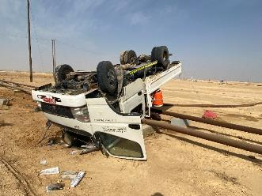
PDO Second Alert
Date: 21.06.2020 Incident title: HiPo#45
What happened?
A civil crew while travelling from Marmul to Qaharir in a 3Ton canter, the vehicle went off the road and the driver lost control resulting in a roll over and rested on to a live flow line (MM 459). No injury to personnel and no damage to the live line, slight damage to the 3 ton canter. Driver and 3 passengers were taken to Tawoos PAC Clinic for post incident medical check-up and found no injury.
Your learning from this incident..
Always follow Life Saving Rules and do not work under influence of alcohol.
Always share any stress with colleagues/friends.
Always contact HSE helpline, incase of any non compliances
Stop the vehicle if feel the condition is unsafe.
Always respect the intervention made by your co-workers.
Think & Drive, Don’t Drink & Drive-So You Survive
Target Audience: Drilling, Logistics, Operation, Engineering, Exploration & construction
Notes:
Ensure all dates and titles are input
A short description should be provided without mentioning names of contractors or individuals. You should include, what happened, to who (by job title) and what injuries this resulted in. Nothing more!
Four to five bullet points highlighting the main findings from the investigation. Remember the target audience is the front line staff so this should be written in simple terms in a way that everyone can understand.
The strap line should be the main point you want to get across
The images should be self explanatory, what went wrong (if you create a reconstruction please ensure you do not put people at risk) and below how it should be done.

Slide 2
Management self audit
Date: 21.06.2020 Incident title: HiPo#45
As a learning from this incident and ensure continual improvement all contract
managers must review their HSE HEMP against the questions asked below
Confirm the following:
Do you ensure that your employees are tested for drug and alcohol use?
Do you ensure that your Drug and alcohol policy is implemented?
Do you conduct random checks to ensure staff are not in possession of illegal substances in camps and PACs?
Do you have a helpline for employees to register their issues and complaints?
Do you ensure that Drivers are briefed on hazards and requirements prior to issue journey?
* If the answer is NO to any of the above questions please ensure you take action to correct this finding.
Notes:
Ensure all dates and titles are input
Make a list of closed questions (only ‘yes’ or ‘no’ as an answer) to ask others if they have the same issues based on the management or HSE-MS failings or shortfalls identified in the investigation.
Imagine you have to audit other companies to see if they could have the same issues.
These questions should start with: Do you ensure…………………?

