Slide 1
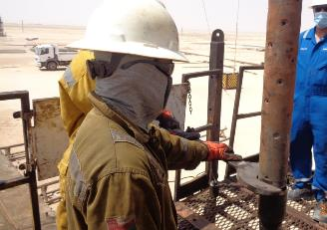
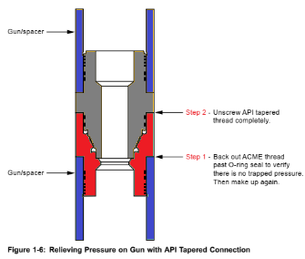
PDO Second Alert
Date: 27.06.2020 Incident title: HiPo#48
What happened?
During POOH of the gun assembly, initial potential trapped pressure was released between Firing Head and Safety Spacer as per procedure. All connections opened up easily. After breaking the connection between GUN #5 and GUN #4 (empty spacer), and while rotating the connection loose to almost a full turn, unexpected trapped pressure from GUN #4, migrated to GUN #5 and there was an uncontrolled released through the open scallops in GUN #5.
Your learning from this incident..
Always use the ACME thread to release potential trapped pressure on un-perforated gun assemblies.
Safety Glasses and Face Mask have prevented further injury on the Roustabout.
Always check with Second Party Supervisor on potential hazards.
Always ensure Second Party is leading the TRIC and are the Permit Holders.
Always expect trapped pressure and work accordingly
Target Audience: Drilling, Logistics, Operation & construction
Notes:
Ensure all dates and titles are input
A short description should be provided without mentioning names of contractors or individuals. You should include, what happened, to who (by job title) and what injuries this resulted in. Nothing more!
Four to five bullet points highlighting the main findings from the investigation. Remember the target audience is the front line staff so this should be written in simple terms in a way that everyone can understand.
The strap line should be the main point you want to get across
The images should be self explanatory, what went wrong (if you create a reconstruction please ensure you do not put people at risk) and below how it should be done.

Slide 2
Management self audit
Date: 27.06.2020 Incident title: HiPo#48
As a learning from this incident and ensure continual improvement all contract
managers must review their HSE HEMP against the questions asked below
Confirm the following:
Do you ensure that the PTWH is the correct person (competent and authorized)?
Do you ensure that your training creates understanding of potential hazards due to different operational conditions?
Do you ensure to review your HAZOP after a Near Miss caused by equipment?
Do you ensure to have procedures and processes in place to ensure all staff are wearing PPE as and when required?
Do you ensure procedural adherence part of your Unit Assurance Plan?
Do you ensure clear communication and job potential hazards discussion with your crew?
* If the answer is NO to any of the above questions please ensure you take action to correct this finding.
Notes:
Ensure all dates and titles are input
Make a list of closed questions (only ‘yes’ or ‘no’ as an answer) to ask others if they have the same issues based on the management or HSE-MS failings or shortfalls identified in the investigation.
Imagine you have to audit other companies to see if they could have the same issues.
These questions should start with: Do you ensure…………………?

