Slide 1
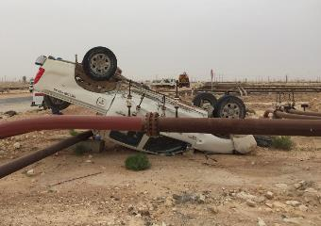
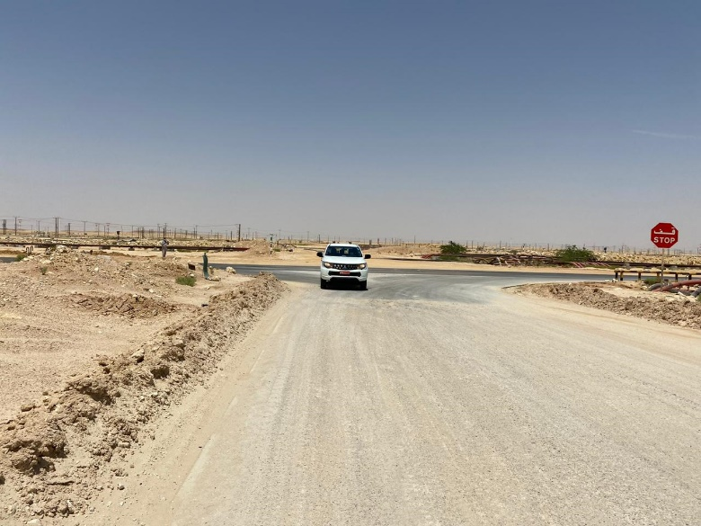
PDO Second Alert
Date: 02.07.2020 Incident title: HiPo#50
What happened?
1ton pick-up while taking a turn from the blacktop towards the A-Station road was hit by a third-party private vehicle which was overtaking from the left side of the pick-up. The impact resulted the pick-up to roll over and fell on the nearby flowline. Driver of both vehicles and passenger in the pick-up were taken to PDO Clinic for post incident medical check-up and declared no injury.
Your learning from this incident..
Always pay attention to the signals by other road users.
Always be alerted for the unexpected at road.
Always follow rules of the road.
Always follow Defensive driving technique.
Always look over your shoulder before crossing the carriageway.
Follow Defensive driving technique and obey signals on road
Target Audience: Drilling, Logistics, Operation, Engineering, Exploration & construction
Notes:
Ensure all dates and titles are input
A short description should be provided without mentioning names of contractors or individuals. You should include, what happened, to who (by job title) and what injuries this resulted in. Nothing more!
Four to five bullet points highlighting the main findings from the investigation. Remember the target audience is the front line staff so this should be written in simple terms in a way that everyone can understand.
The strap line should be the main point you want to get across
The images should be self explanatory, what went wrong (if you create a reconstruction please ensure you do not put people at risk) and below how it should be done.

Slide 2
Management self audit
Date: 02.07.2020 Incident title: HiPo#50
As a learning from this incident and ensure continual improvement all contract
managers must review their HSE HEMP against the questions asked below
Confirm the following:
Do you ensure that your Drivers are following Defensive driving techniques?
Do you ensure that your Drivers are aware about the third party hazards on the road?
Do You ensure that your Drivers always follow the rules of the road?
Do you ensure that Learning from Incidents are cascaded to your drivers?
* If the answer is NO to any of the above questions please ensure you take action to correct this finding.
Notes:
Ensure all dates and titles are input
Make a list of closed questions (only ‘yes’ or ‘no’ as an answer) to ask others if they have the same issues based on the management or HSE-MS failings or shortfalls identified in the investigation.
Imagine you have to audit other companies to see if they could have the same issues.
These questions should start with: Do you ensure…………………?

