Slide 1
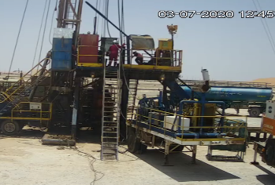
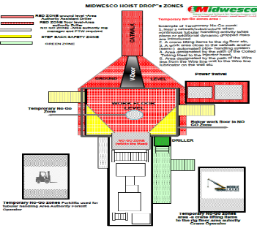
PDO Second Alert
Date: 03.07.2020 Incident title: HiPo#51
What happened?
Hoist was in operation of laying down 3.5” DP joint using the power swivel. Drill pipe joint was hanged up with power swivel for soft break out, then while lowering DP to lay down, drill pipe with FOSV disengaged out of power swivel connection and dropped through the V-door and rested on the ground. No one was injured and No damage to equipment.
Your learning from this incident..
Always comply to the Drops zone management – utilize rig floor Step back safety zone whenever possible.
Always ensure Planning and risk assessments are carried prior any task.
Although it is standard practice, ensure power swivel procedure includes soft break out and laying down drill pipes.
Have a proper respond in place for over torqued connections to soft breakout.
Always ensure efficient leadership for the tasks ahead.
Ensure proper tightness of the connections between power swivel and drill pipe before laying down
Target Audience: Drilling, Logistics, Operation & construction
Notes:
Ensure all dates and titles are input
A short description should be provided without mentioning names of contractors or individuals. You should include, what happened, to who (by job title) and what injuries this resulted in. Nothing more!
Four to five bullet points highlighting the main findings from the investigation. Remember the target audience is the front line staff so this should be written in simple terms in a way that everyone can understand.
The strap line should be the main point you want to get across
The images should be self explanatory, what went wrong (if you create a reconstruction please ensure you do not put people at risk) and below how it should be done.

Slide 2
Management self audit
Date: 03.07.2020 Incident title: HiPo#51
As a learning from this incident and ensure continual improvement all contract
managers must review their HSE HEMP against the questions asked below
Confirm the following:
Do you ensure you QMS maintains operating procedures up to date ?
Do you ensure your crew on site are full aware red zone and no go zone areas?
Do you ensure your supervisors are immediately intervening when issues arises?
Do you ensure employees are fully aware and familiar with standard work practices and procedures?
Do you ensure your key staff are competent enough for their roles and responsibilities?
* If the answer is NO to any of the above questions please ensure you take action to correct this finding.
Notes:
Ensure all dates and titles are input
Make a list of closed questions (only ‘yes’ or ‘no’ as an answer) to ask others if they have the same issues based on the management or HSE-MS failings or shortfalls identified in the investigation.
Imagine you have to audit other companies to see if they could have the same issues.
These questions should start with: Do you ensure…………………?

