Slide 1
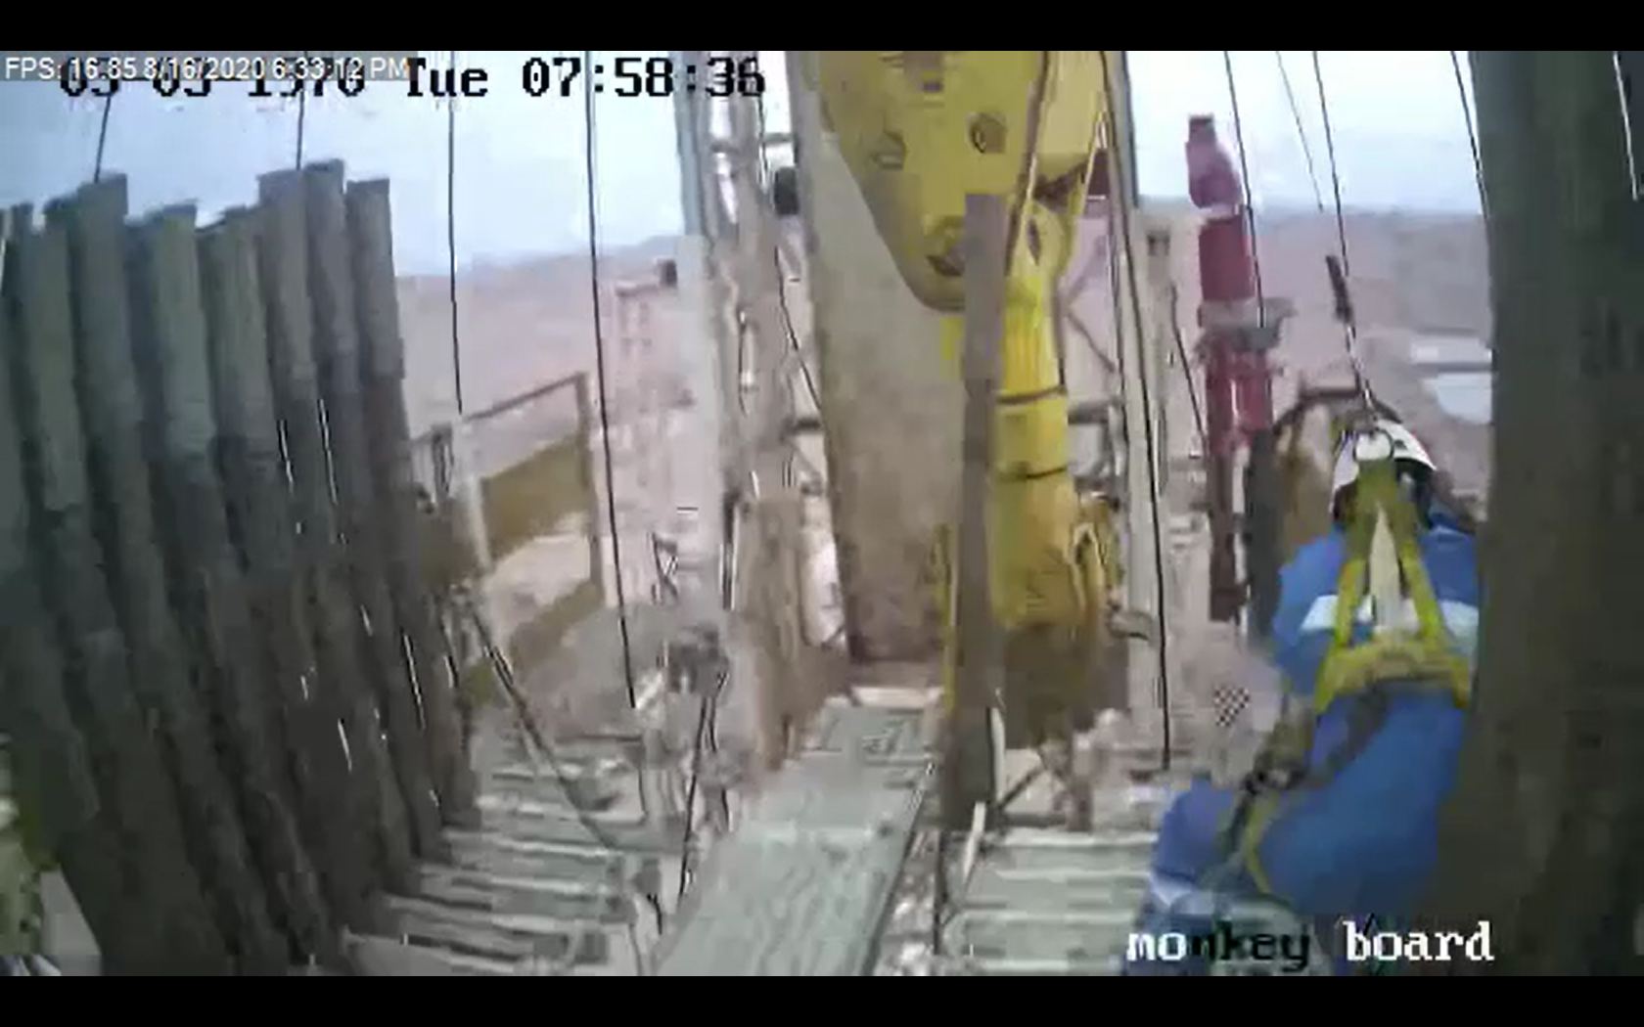
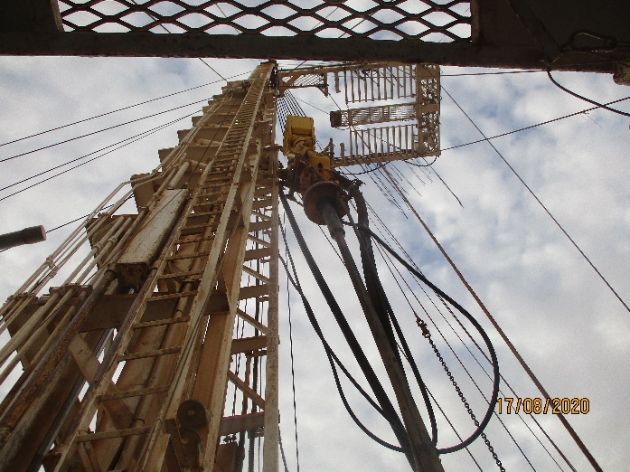
PDO Second Alert
Date: 16.08.2020 Incident title: HiPo#57
What happened?
At approximately 18:33 hrs on 16th of Aug 2020, while pulling out of hole 4 “ heavy weight drill pipe, travelling block touched on the drill pipe stand when the Driller lowered the traveling block before the Derrick man move the drill pipe stand from the travel path of the travelling block. Drill pipe stand bounced towards the monkey board and Derrick man injured when he tripped whilst moving away.
Your learning from this incident..
Always ensure adequate communication is maintained between Drilling crew whilst RIH/POOH activities.
Always give signal to Driller to stop the movement of the travelling block if any potential issues are suspected.
Always move the stands out of the vicinity of the traveling block after unlatching from elevator.
Always ensure that the stands are cleared from path prior to lower the travelling block.
Target Audience: Drilling & construction
Notes:
Ensure all dates and titles are input
A short description should be provided without mentioning names of contractors or individuals. You should include, what happened, to who (by job title) and what injuries this resulted in. Nothing more!
Four to five bullet points highlighting the main findings from the investigation. Remember the target audience is the front line staff so this should be written in simple terms in a way that everyone can understand.
The strap line should be the main point you want to get across
The images should be self explanatory, what went wrong (if you create a reconstruction please ensure you do not put people at risk) and below how it should be done.

Slide 2
Management self audit
Date: 16.08.2020 Incident title: HiPo#57
As a learning from this incident and ensure continual improvement all contract
managers must review their HSE HEMP against the questions asked below
Confirm the following:
Do you ensure adequate communication between the drilling crew whilst RIH/POOH activities?
Do you ensure driller is verifying the travel path before lowing the travelling block?
Do you ensure Derrick man is giving signal to the Driller in case of any delay in retrieving tubulars?
Do you ensure control measures listed in HEMP and SOP are discussed in TBT / safety meetings?
* If the answer is NO to any of the above questions please ensure you take action to correct this finding.
Notes:
Ensure all dates and titles are input
Make a list of closed questions (only ‘yes’ or ‘no’ as an answer) to ask others if they have the same issues based on the management or HSE-MS failings or shortfalls identified in the investigation.
Imagine you have to audit other companies to see if they could have the same issues.
These questions should start with: Do you ensure…………………?

