Slide 1
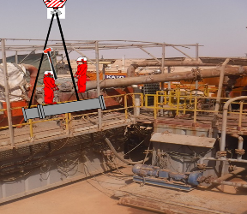
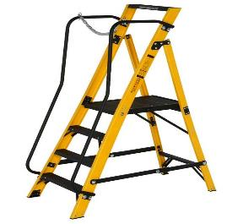
PDO Second Alert
Date: 27.08.2020 Incident title: HiPo#61
What happened?
On 27th August, 2020 @ 07:35 hours, Roustabout to gain height for hammering a above head height job, positioned his right leg on the top trail (Handrail @1m height from mud tank floor) and left leg placed on the still suspended pipe just above the access way of the shale shaker area. The Roustabout was hammering only on the direction of purlins (horizontal to access way) on to the small pipe diameter. On the 4th attempt, the Roustabout lost balance and fell on the right side over the handrail (@ 3.5 m) to the ground, sustaining minor pain in the Hip. First aid administered at the location and transferred to PAC clinic, and further referred for X-ray, the report was clear and RA resumed duty.
Your learning from this incident..
Do not climb out of protected work platform.
Use stable platform /ladder to gain height.
Always secure with safety harness while working at unprotected height.
All crew members need to comply with “Empowerment to Stop” program.
Ensure TBT & TRIC covers all planned activities & after dynamic risks are identified.
Do not use handrails as ladders
Target Audience: Drilling, Logistics, Operation, Engineering, Exploration & construction
Notes:
Ensure all dates and titles are input
A short description should be provided without mentioning names of contractors or individuals. You should include, what happened, to who (by job title) and what injuries this resulted in. Nothing more!
Four to five bullet points highlighting the main findings from the investigation. Remember the target audience is the front line staff so this should be written in simple terms in a way that everyone can understand.
The strap line should be the main point you want to get across
The images should be self explanatory, what went wrong (if you create a reconstruction please ensure you do not put people at risk) and below how it should be done.

Slide 2
Management self audit
Date: 27.08.2020 Incident title: HiPo#61
As a learning from this incident and ensure continual improvement all contract
managers must review their HSE HEMP against the questions asked below
Confirm the following:
Do you always ensure that crew are aware of working at height protocol?
Do you always ensure adequate supervision is maintained for working at height tasks?
Do you always ensure that previous incident learning are shared and understood by crew members?
Do you ensure that random self-verification of on going activities is done?
Do you ensure the Learning from Incident program is well established and effective?
If the answer is NO to any of the above questions please ensure you take action to correct this finding.
Notes:
Ensure all dates and titles are input
Make a list of closed questions (only ‘yes’ or ‘no’ as an answer) to ask others if they have the same issues based on the management or HSE-MS failings or shortfalls identified in the investigation.
Imagine you have to audit other companies to see if they could have the same issues.
These questions should start with: Do you ensure…………………?

