Slide 1
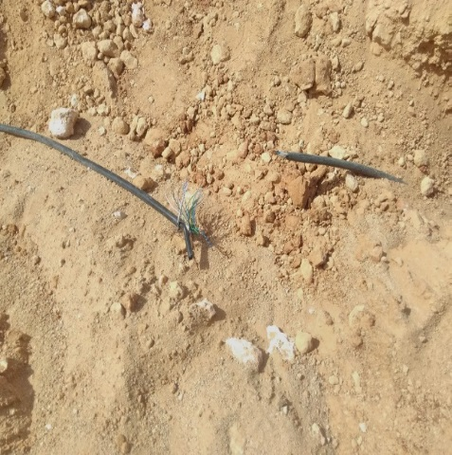
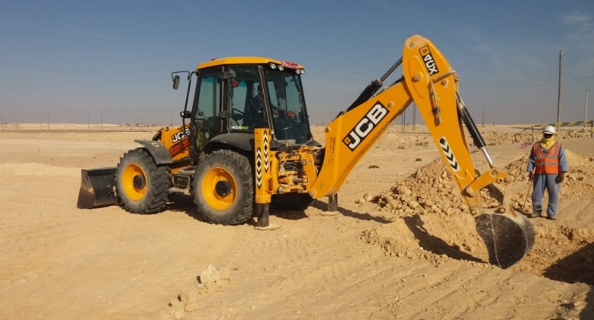
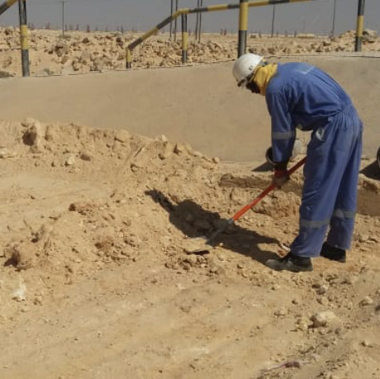
PDO Second Alert
Date: 27.01.2020 Incident title: HVL#01
What happened?
While removing (excavated soil) using backhoe, the bucket teeth came in contact with the live instrument cable laid at 180mm below the ground and cut it in two parts, resulting in tripping of 2 export pumps and 6 wash oil pumps at NRPS, Nimr.
Your learning from this incident..
Always resort to manual means for removal of soil when in doubt.
Always ensure that the waste soil is dumped at a place free from underground services.
Always place waste soil in an area which is easily accessible.
Always know what’s below
Target Audience: Operation, Engineering & Construction
Notes:
Ensure all dates and titles are input
A short description should be provided without mentioning names of contractors or individuals. You should include, what happened, to who (by job title) and what injuries this resulted in. Nothing more!
Four to five bullet points highlighting the main findings from the investigation. Remember the target audience is the front line staff so this should be written in simple terms in a way that everyone can understand.
The strap line should be the main point you want to get across
The images should be self explanatory, what went wrong (if you create a reconstruction please ensure you do not put people at risk) and below how it should be done.

Slide 2
Management self audit
Date: 27.01.2020 Incident title: HVL#01
As a learning from this incident and ensure continual improvement all contract
managers must review their HSE HEMP against the questions asked below
Confirm the following:
Do you ensure as built drawings are available at site to locate underground cables?
Do you ensure that the equipment operators take adequate precautions while working inside live facility where presence of underground services is uncertain?
Do you ensure that the excavation certificate recommendations are fully adhered to?
* If the answer is NO to any of the above questions please ensure you take action to correct this finding.
Notes:
Ensure all dates and titles are input
Make a list of closed questions (only ‘yes’ or ‘no’ as an answer) to ask others if they have the same issues based on the management or HSE-MS failings or shortfalls identified in the investigation.
Imagine you have to audit other companies to see if they could have the same issues.
These questions should start with: Do you ensure…………………?

