Slide 1
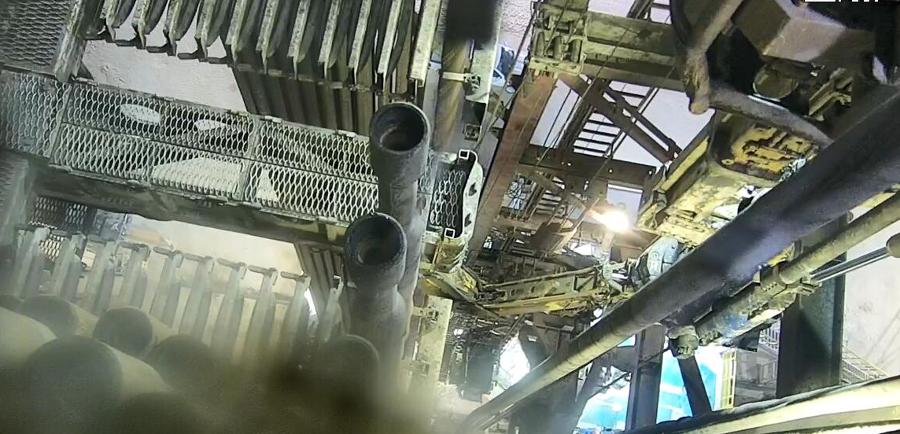
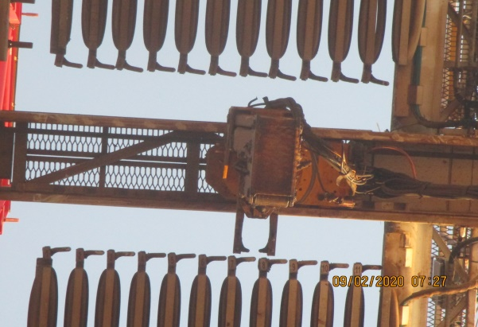
PDO Second Alert
Date: 06.02.2020 Incident title HVL#02
What happened?
The operation was to install wear bushing using one stand of 5” HWDP. One stand of 5” HWDP stand was transferred to the hydraulic elevator by STV( Stand Transfer Vehicle). After that, the derrick man retracted the arm of STV out of the well centre to the monkey board side and connecting wear bushing Running Tool (R/T), the driller started to RIH when he suddenly noticed indication of weight slack off. He stopped to check and found that hydraulic elevator did hit the STV ( untracked accidentally without control) resulting in a bend of diving board & sheared two lock screw bars,3 pins dropped on the rig floor. Each weight= 387g height is 26 m. Nobody was standing in the red zone.
Your learning from this incident..
Always follow STV operation SOP (put in parking position when not used)
Always check the surrounding condition of traveling block before operate traveling block.
Always Ensure HPU of STV is power off during drilling operation.
Always Ensure secondary retention is in place for any potential dropped object.
Photo explaining what was done wrong
STV in the well center position
Photo explaining how it should be done right
STV in the parking position
Always ensure STV( Stand Transfer Vehicle) in the parking position before a lower traveling block
Target Audience: Drilling, Operations, Logistics, Engineering & Construction
Notes:
Ensure all dates and titles are input
A short description should be provided without mentioning names of contractors or individuals. You should include, what happened, to who (by job title) and what injuries this resulted in. Nothing more!
Four to five bullet points highlighting the main findings from the investigation. Remember the target audience is the front line staff so this should be written in simple terms in a way that everyone can understand.
The strap line should be the main point you want to get across
The images should be self explanatory, what went wrong (if you create a reconstruction please ensure you do not put people at risk) and below how it should be done.

Slide 2
Management self audit
Date: 06.02.2020 Incident title HVL#02
As a learning from this incident and ensure continual improvement all contract
managers must review their HSE HEMP against the questions asked below
Confirm the following:
Do you ensure the STV PMS covered the frequency of changing seals?
Do you ensure secondary retention is in place for any potential dropped object?
Do you ensure following the HPU “OFF” during equipment not in used?
Do you ensure proper handover done at rig site ?
* If the answer is NO to any of the above questions please ensure you take action to correct this finding.
Notes:
Ensure all dates and titles are input
Make a list of closed questions (only ‘yes’ or ‘no’ as an answer) to ask others if they have the same issues based on the management or HSE-MS failings or shortfalls identified in the investigation.
Imagine you have to audit other companies to see if they could have the same issues.
These questions should start with: Do you ensure…………………?

