Slide 1
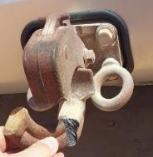
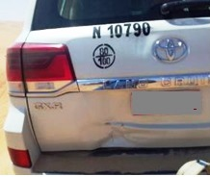
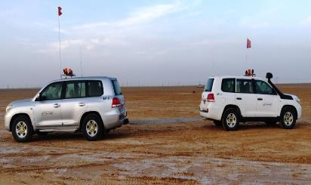
PDO Second Alert
Date: 07.03.2020 Incident title: HVL#03
What happened?
A Station Wagon became stuck on a low sand dune ridge while scouting the area. Another vehicle was used as a recovery vehicle. Heavy duty tow straps, along with shackles were secured to the tow hitches at the rear of both vehicles. During the towing process, the tow hitch of the stuck vehicle broke, resulting in sudden release of shackles with tow straps and direct impact to the rear of vehicle and roof mounted spotlight of this vehicle. No injury was sustained during the incident.
Your learning from this incident..
Always Ensure that towing procedure is followed.
Always ensure that proper towing loops/recovery attachment point used.
Always ensure that towing hitches are working & Not jammed.
Always secure the recovery straps directly to towing points.
Always use the correct recovery straps for towing operations.
Always Use Correct Towing procedures, Avoid excessive Jerk
Target Audience: Drilling, Operations, Logistics, Exploration, Engineering & Construction
Notes:
Ensure all dates and titles are input
A short description should be provided without mentioning names of contractors or individuals. You should include, what happened, to who (by job title) and what injuries this resulted in. Nothing more!
Four to five bullet points highlighting the main findings from the investigation. Remember the target audience is the front line staff so this should be written in simple terms in a way that everyone can understand.
The webbing slings line should be the main point you want to get across
The images should be self explanatory, what went wrong (if you create a reconstruction please ensure you do not put people at risk) and below how it should be done.

Slide 2
Management self audit
Date: 07.03.2020 Incident title: HVL#03
As a learning from this incident and ensure continual improvement all contract
managers must review their HSE RAR against the questions asked below
Confirm the following:
Do you ensure that tow hitches are properly serviced and maintained?
Do you ensure that vehicle are towing smoothly?
Do you ensure that right kind of recovery strap is using for towing?
Do you ensure all towing equipment in controlled system?
Do you ensure all towing equipments are certified?
Do you ensure that all the incident learning and updated HSE procedures are discussed & communicated in detail to all staff including working on other project (internal learning)?
Do you ensure that all workers stop and rest when tired.?
Do you ensure all towing operation team members are trained and authorized to perform work?
* If the answer is NO to any of the above questions please ensure you take action to correct this finding.
Notes:
Ensure all dates and titles are input
Make a list of closed questions (only ‘yes’ or ‘no’ as an answer) to ask others if they have the same issues based on the management or HSE-MS failings or shortfalls identified in the investigation.
Imagine you have to audit other companies to see if they could have the same issues.
These questions should start with: Do you ensure…………………?

