Slide 1
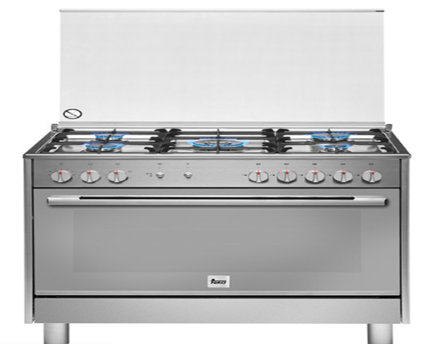
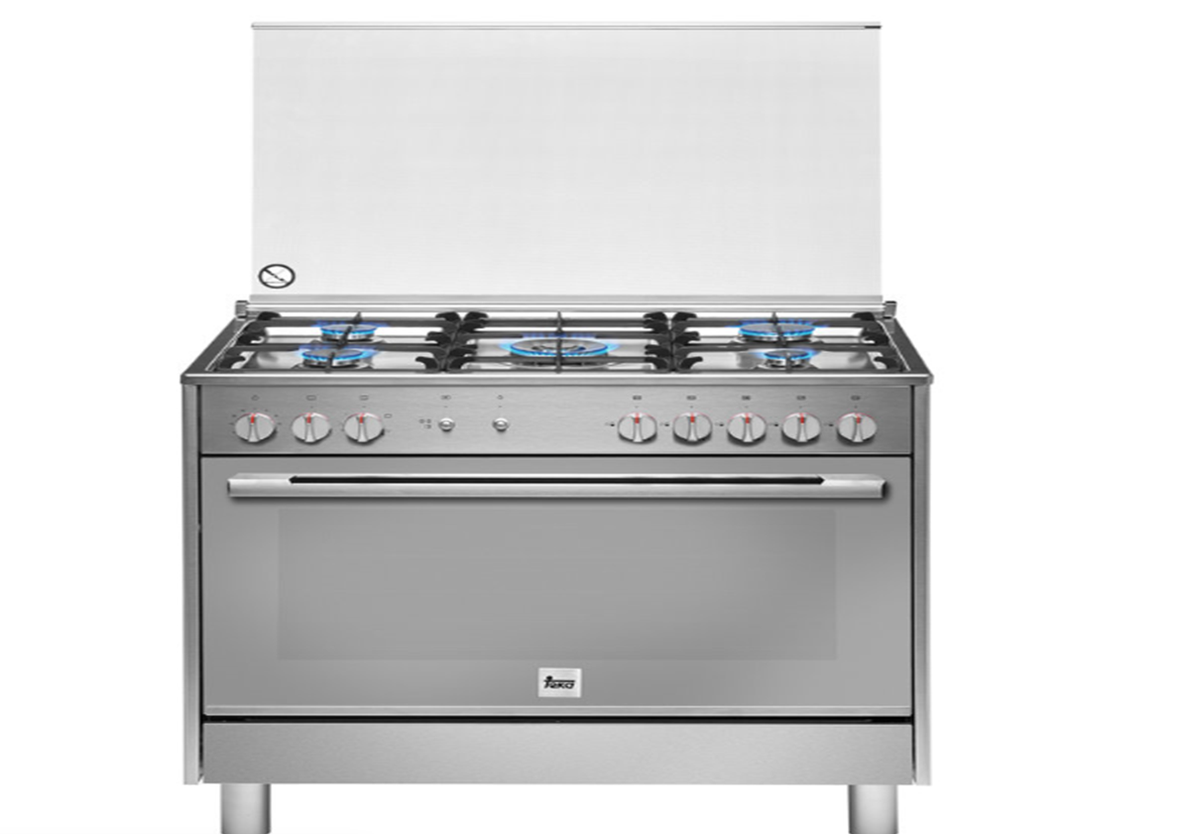
PDO Second Alert
Blue plastic protective covering, on front of cooker/ sides / and inside of oven door
Date: 21.02.2020 Incident title: HVL#04
What happened?
A new gas oven was used tor the first time to cook some food, after 20 mins a fire occurred, reasons are not fully clear however there is strong evidence that suggests that the plastic covering protecting the stainless steel on the sides an oven door had not been fully removed. Therefore when the oven was used for the first time the plastic covering acted like an accelerant and ignited the cooking oil causing a fire in the Dirty Room of a Villa.
Your learning from this incident..
You must be deemed competent / qualified to install this equipment.
You must remove all transit and protective coverings before the gas cooker is installed.
You must call PDO emergency number when there has been serious event such as a fire.
You must make sure that the Emergency Services know your correct location when called.
No Blue plastic protective covering, on front of cooker/ sides / and inside of oven door
Ignore Fire Safety – Loose Lives!
Target Audience: Construction, Infrastructure & Utilities
Notes:
Ensure all dates and titles are input
A short description should be provided without mentioning names of contractors or individuals. You should include, what happened, to who (by job title) and what injuries this resulted in. Nothing more!
Four to five bullet points highlighting the main findings from the investigation. Remember the target audience is the front line staff so this should be written in simple terms in a way that everyone can understand.
The strap line should be the main point you want to get across
The images should be self explanatory, what went wrong (if you create a reconstruction please ensure you do not put people at risk) and below how it should be done.

Slide 2
Management self audit
Date: 21.02.2020 Incident title: HVL#04
As a learning from this incident and ensure continual improvement all contract
managers must review their HSE RAR against the questions asked below
Confirm the following:
Do you ensure that you install, maintain equipment as per manufacture recommendations?
Do you ensure that all packing and transit material has been removed from the item before use?
Do you ensure that a commissioning certificate is issued for new gas installations?
Do you ensure that end user understands not to leave gas appliances unattended once in operation?
Do you ensure that the manufactures ‘Before Use’ instructions are followed?
* If the answer is NO to any of the above questions please ensure you take action to correct this finding.
Notes:
Ensure all dates and titles are input
Make a list of closed questions (only ‘yes’ or ‘no’ as an answer) to ask others if they have the same issues based on the management or HSE-MS failings or shortfalls identified in the investigation.
Imagine you have to audit other companies to see if they could have the same issues.
These questions should start with: Do you ensure…………………?

