Slide 1
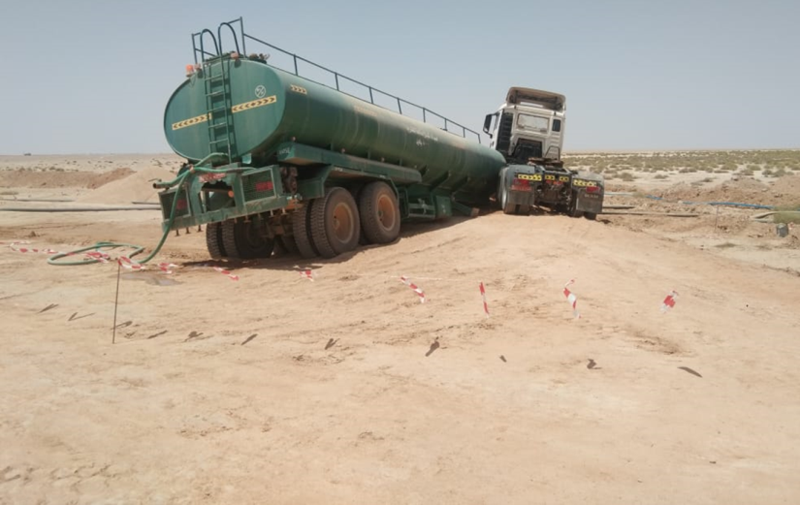
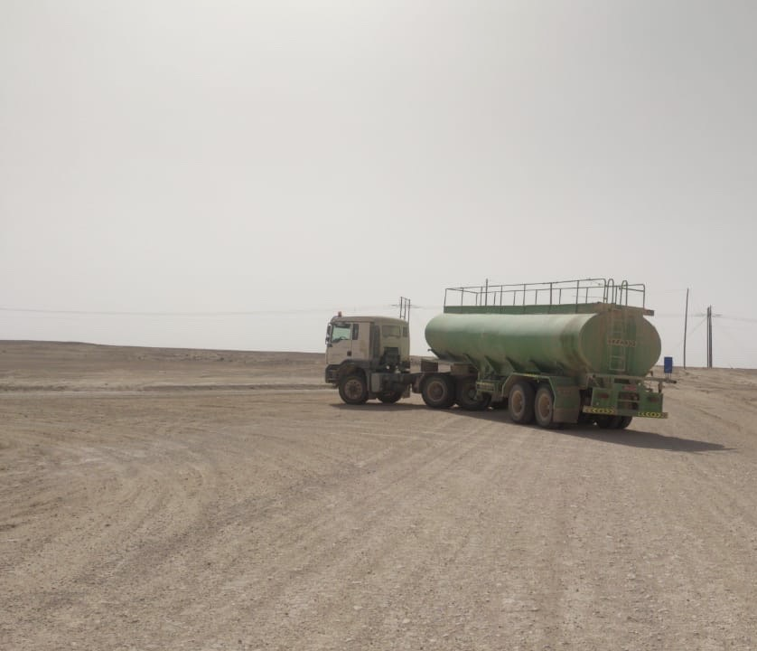
PDO Second Alert
Date: 09.04.2020 Incident title HVL#05
What happened?
While A Hired water tanker on the way to Shujairat- 02 from Sakhiya water well on graded road while negotiating left turn, the tanker trailer detached from the prime mover. Slight Asset damaged to the water tanker. No injury to personnel. PDO and RSST were informed. Slight Damage to water tanker.
Your learning from this incident..
Always use defensive driving techniques to utilize the available space for turning heavy vehicles.
Encourage drivers to Always report poor road conditions to Journey Office.
Always ensure that your vehicle is inspected and fit to drive.
Always conduct route survey prior deploying heavy vehicles.
Driver took close turn to the edge of the road
Always assess the turning circle
Driver utilizing the available turning space
Target Audience: Drilling, Operations, Logistics, Exploration, Engineering & Construction
Notes:
Ensure all dates and titles are input
A short description should be provided without mentioning names of contractors or individuals. You should include, what happened, to who (by job title) and what injuries this resulted in. Nothing more!
Four to five bullet points highlighting the main findings from the investigation. Remember the target audience is the front line staff so this should be written in simple terms in a way that everyone can understand.
The strap line should be the main point you want to get across
The images should be self explanatory, what went wrong (if you create a reconstruction please ensure you do not put people at risk) and below how it should be done.

Slide 2
Management self audit
Date: 09.04.2020 Incident title HVL#05
As a learning from this incident and ensure continual improvement all contract
managers must review their HSE HEMP against the questions asked below
Confirm the following:
Do you ensure that the roads are adequately prepared for movement of long vehicles?
Do you ensure that your drivers are reporting poor road conditions to SJM?
Do you ensure that your drivers are familiar with the interior graded roads?
Do you ensure that all your vehicle undergo periodic maintenance and inspections?
Do you conduct road survey and ensure accessibility of heavy equipment on ROW in the construction phase?
* If the answer is NO to any of the above questions please ensure you take action to correct this finding.
Notes:
Ensure all dates and titles are input
Make a list of closed questions (only ‘yes’ or ‘no’ as an answer) to ask others if they have the same issues based on the management or HSE-MS failings or shortfalls identified in the investigation.
Imagine you have to audit other companies to see if they could have the same issues.
These questions should start with: Do you ensure…………………?

