Slide 1
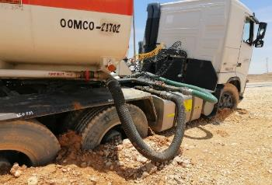
PDO Second Alert
Date: 30.05.2020 Incident title HVL#09
What happened?
On 30th May 2020 , A diesel tanker driver got his tanker stuck while trying to stop outside the paved road between Harweel and Marmul during the recent heavy rains in the South. He stayed for almost 44 hours till the time when he was reported by emergency team during their daily tour, he was very tired and immediately transferred by ambulance to Harweel PDO clinic for further medical examination.
Your learning from this incident..
Always stick to the basics of defensive driving, where you should stop the vehicle under deteriorate weather condition.
Always ensure to obey to weather forecasts alerts and afforded help.
Always ensure proper planning , communication and execution of journey plan.
Always ensure to follow nominated journey management safeguards.
Always follow journey management emergency procedure and call 24385555 in any emergency.
Vehicle was stuck in soft ground
Call 24385555 in any emergency case
Follow safe journey management process
Target Audience: Drilling, Operations, Logistics, Exploration, Engineering & Construction
Notes:
Ensure all dates and titles are input
A short description should be provided without mentioning names of contractors or individuals. You should include, what happened, to who (by job title) and what injuries this resulted in. Nothing more!
Four to five bullet points highlighting the main findings from the investigation. Remember the target audience is the front line staff so this should be written in simple terms in a way that everyone can understand.
The strap line should be the main point you want to get across
The images should be self explanatory, what went wrong (if you create a reconstruction please ensure you do not put people at risk) and below how it should be done.

Slide 2
Management self audit
Date: 30.05.2020 Incident title HVL#09
As a learning from this incident and ensure continual improvement all contract
managers must review their HSE HEMP against the questions asked below
Confirm the following:
Do you ensure you proper implementation of journey management emergency procedure?
Do you ensure implementation & test of emergency response procedure?
Do you ensure effective management of weather warning and forecasts?
Do you ensure effective management of contractors?
Does your sub contractor have a pre-qualification assessment and an audit procedure/ program for their subcontractor?
Do you ensure competent driver and journey manager carried out the task?
Do you ensure adequate Safety brief prior journey started?
* If the answer is NO to any of the above questions please ensure you take action to correct this finding.
Notes:
Ensure all dates and titles are input
Make a list of closed questions (only ‘yes’ or ‘no’ as an answer) to ask others if they have the same issues based on the management or HSE-MS failings or shortfalls identified in the investigation.
Imagine you have to audit other companies to see if they could have the same issues.
These questions should start with: Do you ensure…………………?

