Slide 1
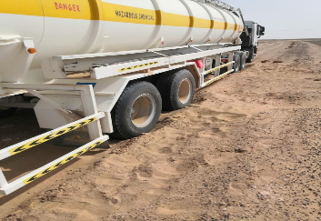
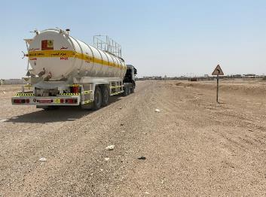
PDO Second Alert
Date: 10.06.2020 Incident title HVL#10
What happened?
On 10th Jun 2020, three third party vehicles departed in convoy from rig-31 Raba to rig-43 in Wadi Musallam. Before reaching the rig site, one of the vacuum tanker driver took shortcut and stucked in sand at 11:35.
Your learning from this incident..
Always follow the agreed route in the JMP and don’t take any shortcuts
Always respect the convoy procedures and keep appropriate distance to stay together
Don’t hesitate to intervene if you saw a colleague driver taking shortcut from convoy, remember your intervention is for their safety
Safe Journey Managers ensure engagement with the driver prior trip and agreement on the route of the trip
Safe Journey Managers always ensure intervention if any deviations noted from identified route when monitoring journey live tracking
Keep strong communication between drivers and journey managers
Always report any unsafe condition on the roads
Enhance safe journey management for all Contractors and Sub-Contractors.
Always follow Safe Journey Management
Target Audience: Drilling, Operations, Logistics, Exploration, Engineering & Construction
Notes:
Ensure all dates and titles are input
A short description should be provided without mentioning names of contractors or individuals. You should include, what happened, to who (by job title) and what injuries this resulted in. Nothing more!
Four to five bullet points highlighting the main findings from the investigation. Remember the target audience is the front line staff so this should be written in simple terms in a way that everyone can understand.
The strap line should be the main point you want to get across
The images should be self explanatory, what went wrong (if you create a reconstruction please ensure you do not put people at risk) and below how it should be done.

Slide 2
Management self audit
Date: 10.06.2020 Incident title HVL#10
As a learning from this incident and ensure continual improvement all contract
managers must review their HSE HEMP against the questions asked below
Confirm the following:
Do you ensure the HEMP covering all aspects in regards to road safety and safe journey management and communicated to key personnel (i.e. through workshops, etc.)?
Do you ensure that a TBT taking place as a part of the Journey Management Process?
Do you ensure that the drivers are familiar with the authorized/approved roads/areas as per assessed roads by the company?
Do you ensure that your Journey Management Plan audits cover the quality of Journey risk assessments?
Do you ensure all subcontractors are covered under HSE monitoring and auditing plan?
* If the answer is NO to any of the above questions please ensure you take action to correct this finding.
Notes:
Ensure all dates and titles are input
Make a list of closed questions (only ‘yes’ or ‘no’ as an answer) to ask others if they have the same issues based on the management or HSE-MS failings or shortfalls identified in the investigation.
Imagine you have to audit other companies to see if they could have the same issues.
These questions should start with: Do you ensure…………………?

