Slide 1
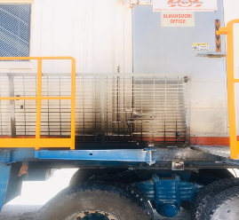
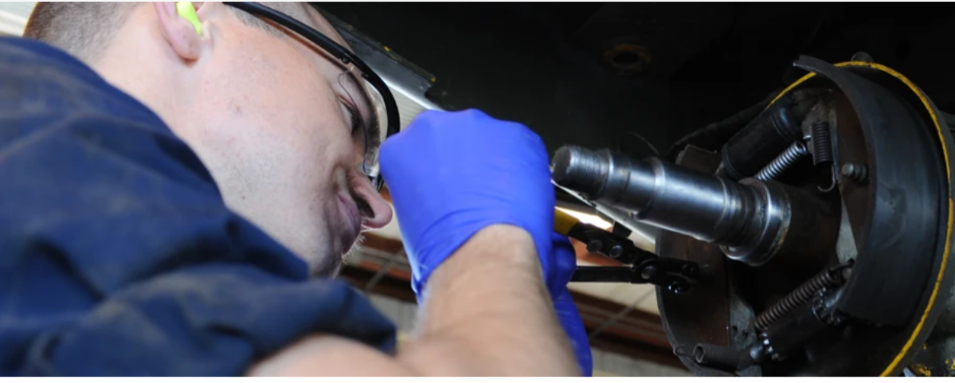
PDO Second Alert
Date: 05.06.2020 Incident title HVL#12
What happened?
On 5th of June 2020 at 09:00hours, Lab cabin trailer left the site BRNN 11 to BRNN 10 with escort vehicle. 10 kms from the site at 9:15, the rear right inner tire blow out and caught fire. Driver stopped the trailer and the escort vehicle immediately extinguished the fire using fire extinguishers and called the field emergency numbers.
Your learning from this incident..
Always consider possible mechanical parts failures.
Always concentrate on the back of trailer while driving.
Always ensure the competency and compliance of maintenance team.
Always ensure sufficient availability of emergency equipment.
Always ensure to comply with trailers SP2000 Maintenance requirements
Target Audience: Drilling, Operations, Logistics, Exploration, Engineering & Construction
Notes:
Ensure all dates and titles are input
A short description should be provided without mentioning names of contractors or individuals. You should include, what happened, to who (by job title) and what injuries this resulted in. Nothing more!
Four to five bullet points highlighting the main findings from the investigation. Remember the target audience is the front line staff so this should be written in simple terms in a way that everyone can understand.
The strap line should be the main point you want to get across
The images should be self explanatory, what went wrong (if you create a reconstruction please ensure you do not put people at risk) and below how it should be done.

Slide 2
Management self audit
Date: 05.06.2020 Incident title HVL#12
As a learning from this incident and ensure continual improvement all contract
managers must review their HSE HEMP against the questions asked below
Confirm the following:
Do you ensure the competency of the driver ?
Do you ensure the competency of the maintenance team ?
Do you ensure the compliance of SP2000 maintenance requirements ?
Do you ensure inner mechanical parts are included in maintenance plans?
Do you ensure inspection on tire and brake systems of trailers is Mileage based SP2000?
* If the answer is NO to any of the above questions please ensure you take action to correct this finding.
Notes:
Ensure all dates and titles are input
Make a list of closed questions (only ‘yes’ or ‘no’ as an answer) to ask others if they have the same issues based on the management or HSE-MS failings or shortfalls identified in the investigation.
Imagine you have to audit other companies to see if they could have the same issues.
These questions should start with: Do you ensure…………………?

