Slide 1
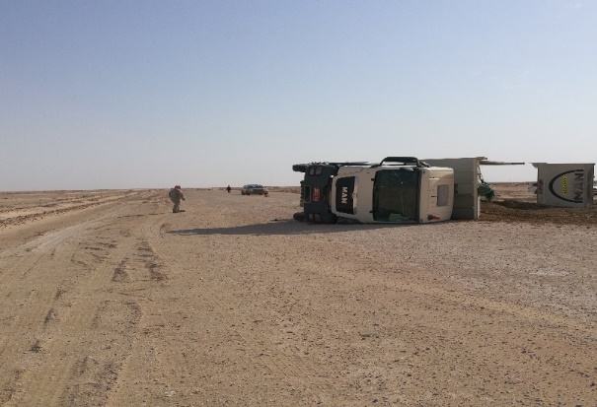
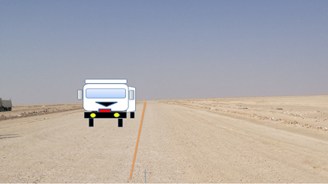
PDO Second Alert
Date: 14.08.2020 Incident title: HiPo#56
What happened?
A tipper tipped over while coming from Fayyad-01 to Bahja waste yard. The tipper was the first vehicle of a convoy of 4 tippers loaded with dry oily sand. The tippers were approximately 2 kms from each other. About. 3 kilometres before reaching Bahja waste yard, while giving clearance to a pick- up coming from opposite side, the driver lost control over the vehicle and moved a bit to right side. The right side tyres entered into soft sand. The driver lost control over the vehicle. He tried to regain control but the vehicle skidded and tipped over at 14:24 hrs.
Your learning from this incident..
Do not drive if you feel fatigue.
Always keep your attention on road while driving.
Permit holder to ensure equal distribution of load.
Journey manager should mention the area, time and number of trips properly in journey plan.
Driver to be alert always when he is at the wheel
Target Audience: Drilling, Logistics, Operation, Engineering, Exploration & construction
Notes:
Ensure all dates and titles are input
A short description should be provided without mentioning names of contractors or individuals. You should include, what happened, to who (by job title) and what injuries this resulted in. Nothing more!
Four to five bullet points highlighting the main findings from the investigation. Remember the target audience is the front line staff so this should be written in simple terms in a way that everyone can understand.
The strap line should be the main point you want to get across
The images should be self explanatory, what went wrong (if you create a reconstruction please ensure you do not put people at risk) and below how it should be done.

Slide 2
Management self audit
Date: 14.08.2020 Incident title: HiPo#56
As a learning from this incident and ensure continual improvement all contract
managers must review their HSE HEMP against the questions asked below
There has been no management system failure in this incident
Confirm the following:
1. Do you ensure all drivers are competent and experienced?
2. Do you ensure load is evenly distributed before the trip?
3. Do you ensure the journey is scheduled as per the work requirement?
4. Do you ensure all the driver had enough rest and is physically fit to work ?
* If the answer is NO to any of the above questions please ensure you take action to correct this finding.
Notes:
Ensure all dates and titles are input
Make a list of closed questions (only ‘yes’ or ‘no’ as an answer) to ask others if they have the same issues based on the management or HSE-MS failings or shortfalls identified in the investigation.
Imagine you have to audit other companies to see if they could have the same issues.
These questions should start with: Do you ensure…………………?

