Slide 1
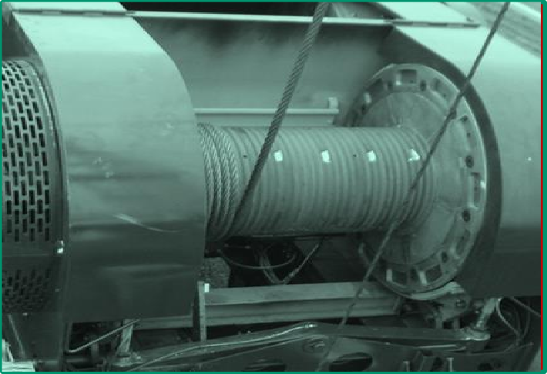
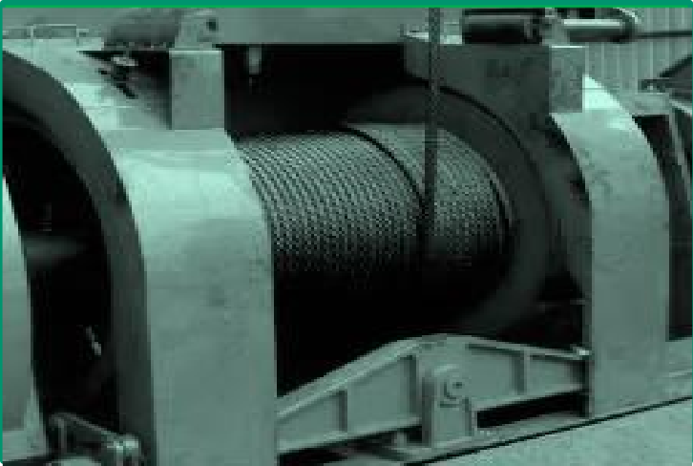
PDO Second Alert
Date: 27.08.2020 Incident title: HiPo#60
What happened?
On 27th of August 2020 at 08:37 am the rig was waiting for rigging up casing
gears. The travelling block was parked at a height of approximately 4.7 mtrs. from the rig floor. Suddenly the block descended and rested on the rig floor. During this event, the fast line got removed from the fast line clamp and travelled through the fast line sheave and dropped to the rig floor. The fast line clamp was found lying close to the draw works on the rig trailer bed.
Your learning from this incident..
(This must solely relate to the people at risk of harm or people at risk of causing the harm)
Photo explaining what
was done wrong
Always ensure that slip and cut job is carried out based on SOP and with consideration of OEM requirement.
Always Ensure that Slip and Cut operation is supervised by Site
Supervisor.
Always Ensure that Drawwork, brake system and other drill lines are daily checked with accordance to field checklist.
Always perform critical task under PTW system.
Always ensure TBT is conducted before job.
Always maintain minimum wraps on drawwork as per OEM requirement & SOP
Target Audience: Drilling & Operation

Slide 2
Management self audit
Date: 27.08.2020 Incident title: HiPo#60
As a learning from this incident and ensure continual improvement all contract managers must review their HSE HEMP against the questions asked below
Confirm the following:
Do you ensure that SOP for slip and cut operation is developed considering OEM?
Do you ensure that effective routine checks on brake systems are carried out?
Do you ensure that CCTV is covering all critical areas and active at all times?
Do you ensure that effective process in place to review and update SOP?
Do you ensure that all critical tasks are performed under PTW system?
Do you ensure that pre job meetings (TBT) are conducted and effective?
* If the answer is NO to any of the above questions please ensure you take action to correct this finding.

