Slide 1
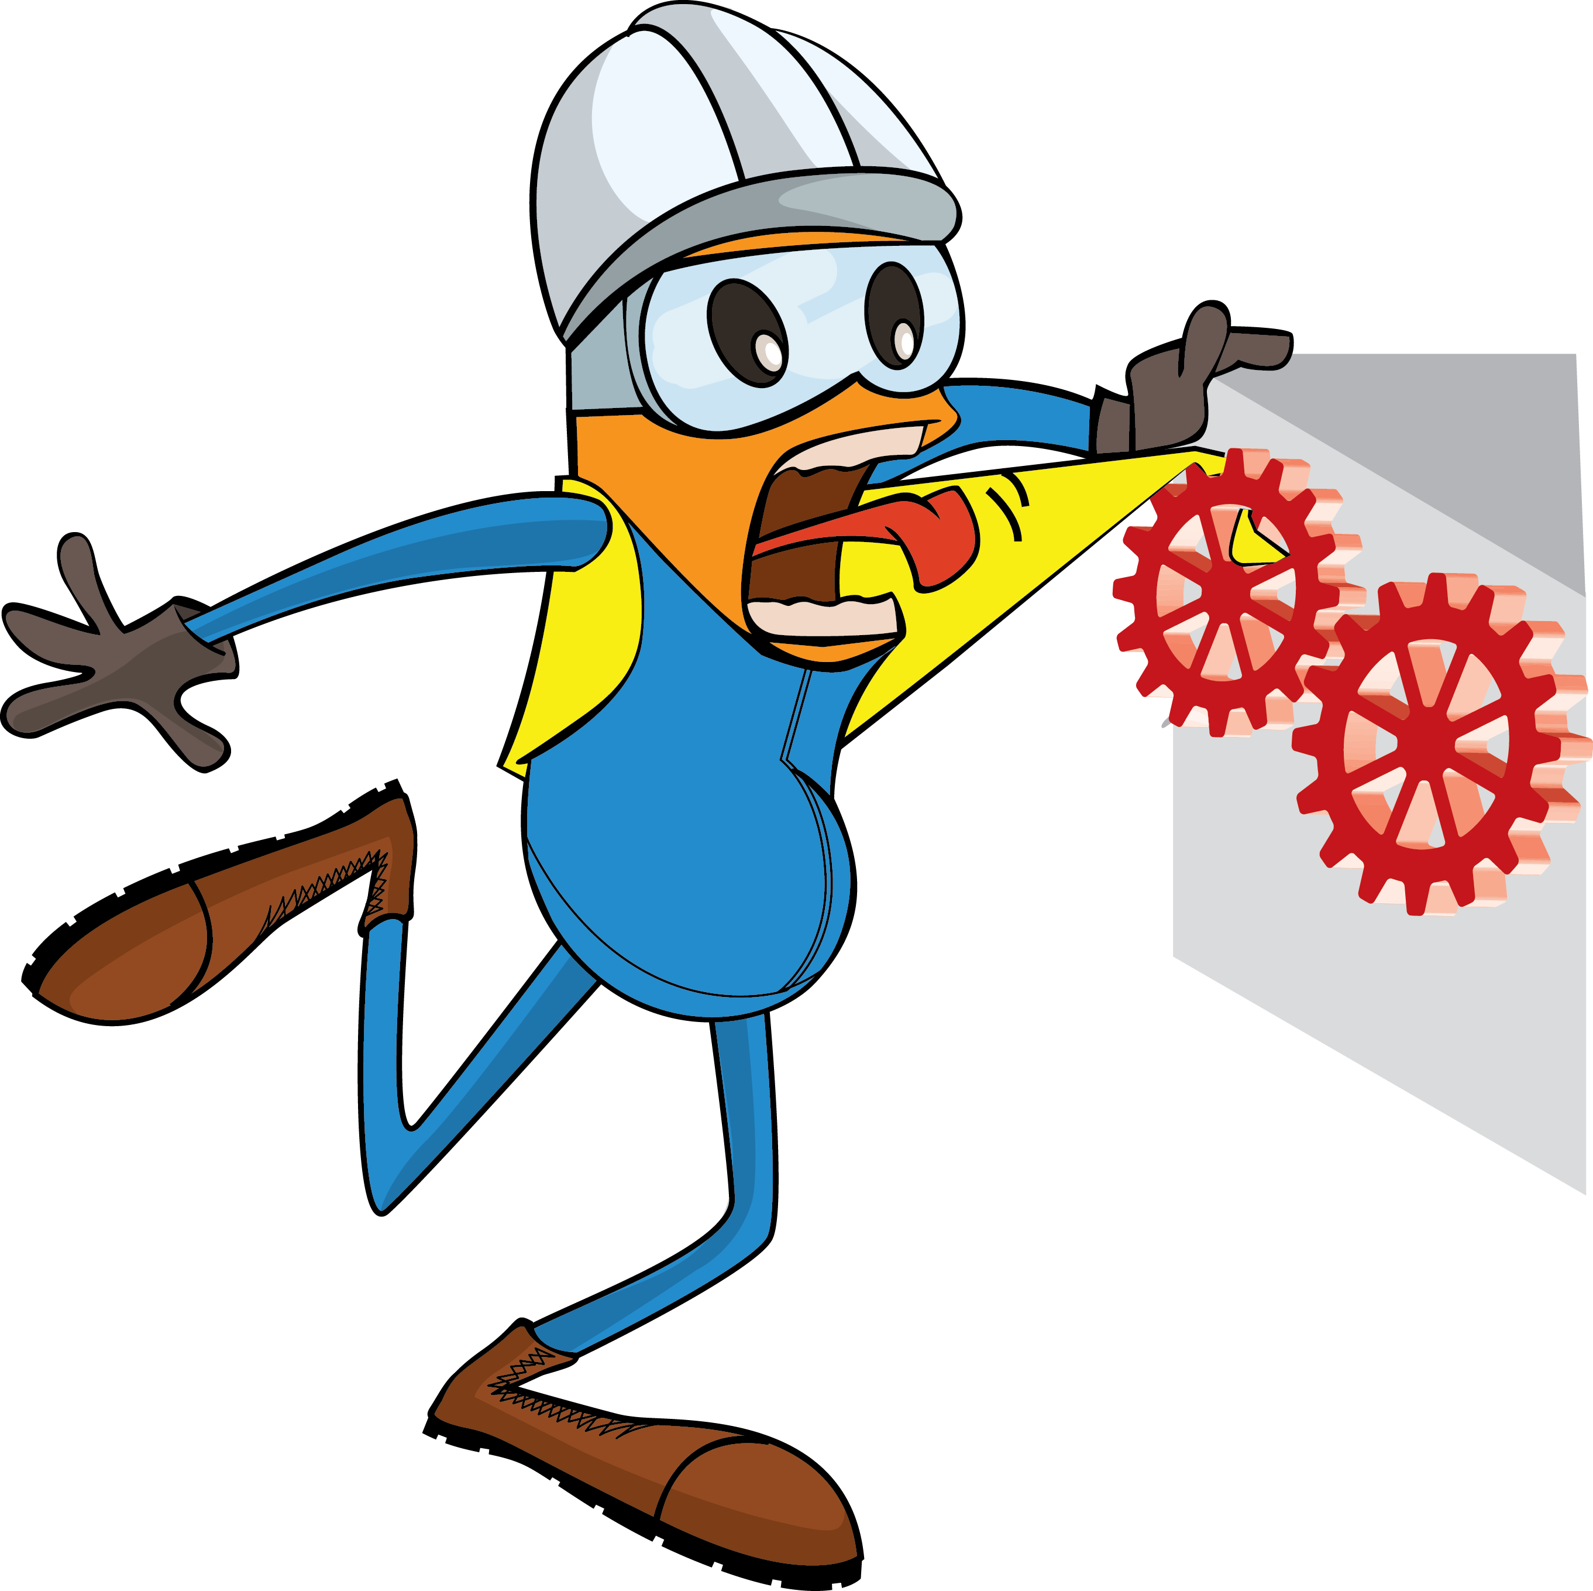
PDO Incident First Alert
Incident Type | LTI#31 | Pattern | Hands & fingers
Date / Time | 15.12.2020 @ 09:50hrs | Directorate
Location | Marmul | Dept
Target Audience
Construction, Operations, Logistics, Engineering , Exploration & Drilling
What happened
While cutting wooden pieces for wedge supports, the carpenters left hand struck the machine blade resulting a deep cut of the left palm, extending to the 3rd finger and fracturing 2 others.
Mr. Musleh asks the questions of can it happen to you?
Do you ensure your Hands & Fingers are away from ‘Line of Fire’?
Do you ensure you identify all hazards before starting a task?
Do you always use hands free tools/ push stick to push material into the cutting area?
Cutting point
Please disseminate this LTI notification to your teams and use it in your tool box talks and HSE meetings and notice boards.

