Slide 1
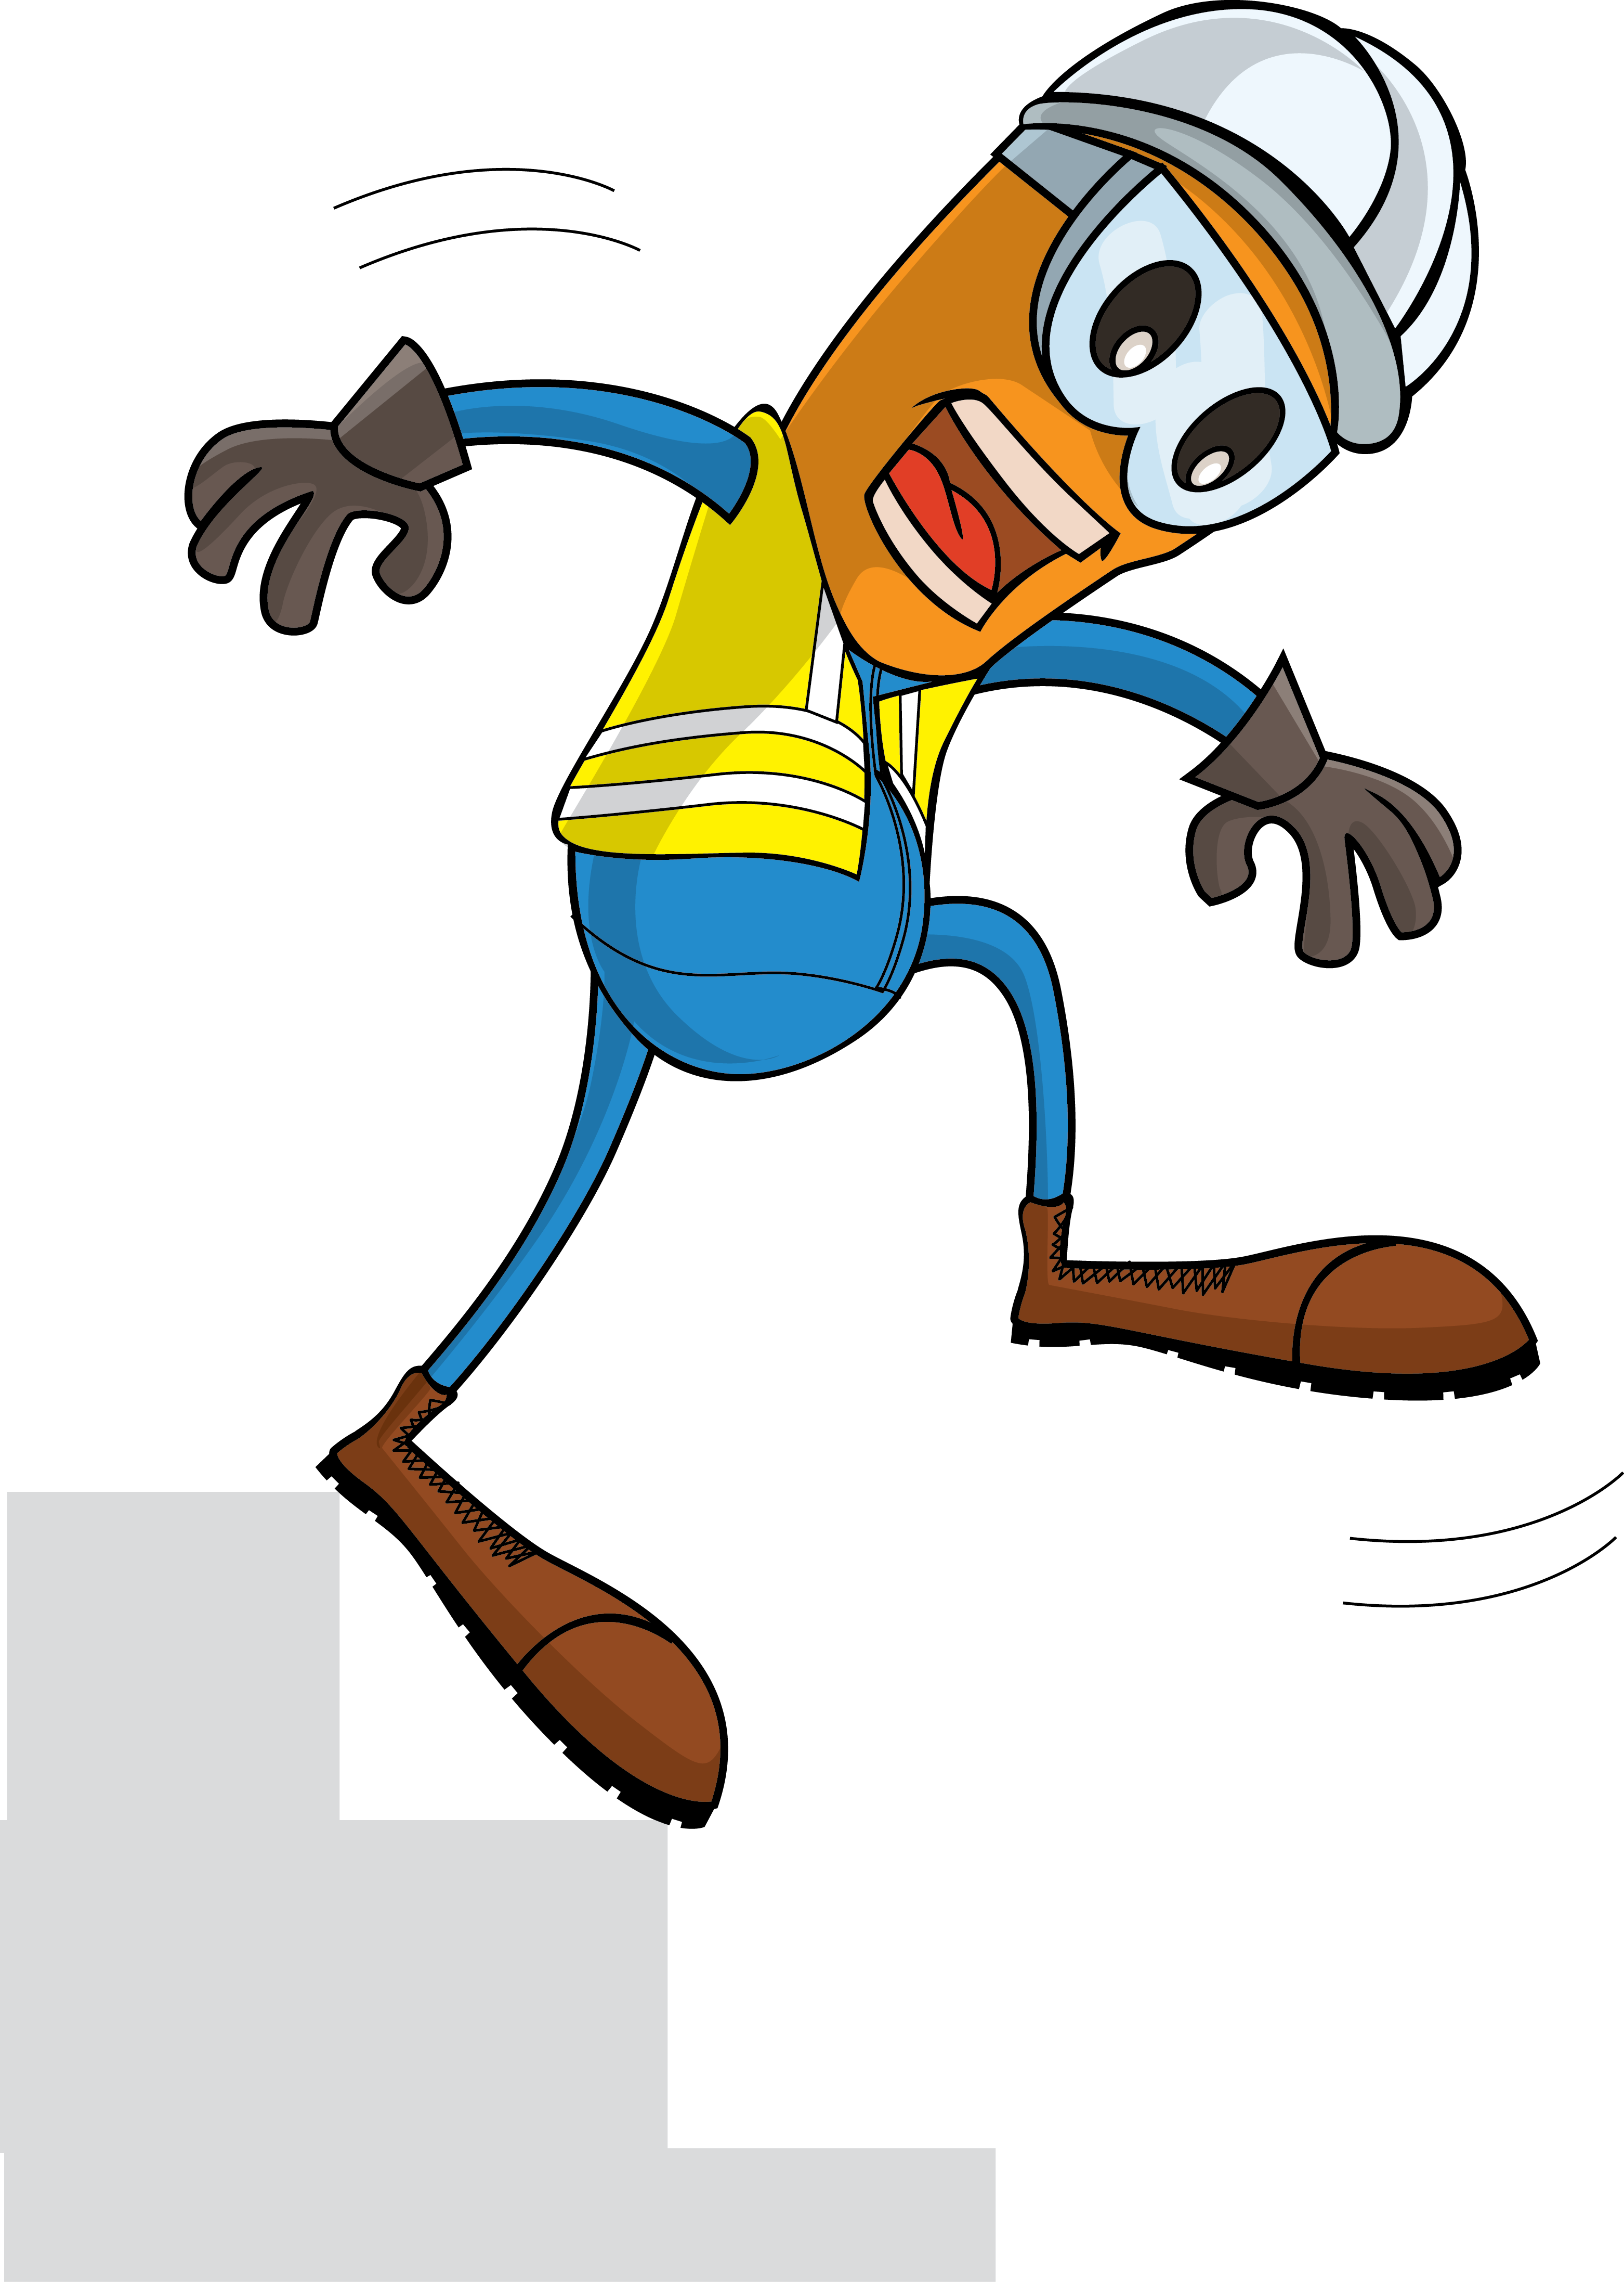
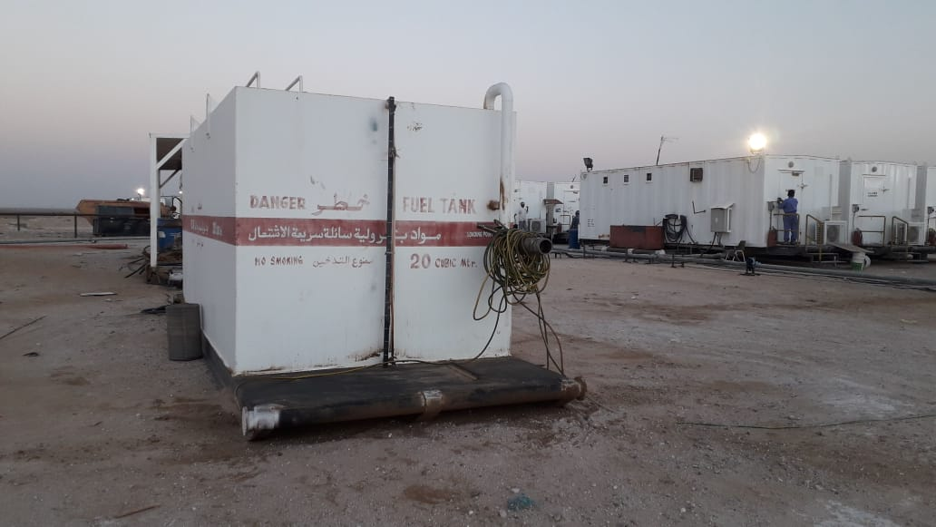
PDO Incident First Alert
Incident Type | LTI#32 | Pattern | Slip, Trip & Fall
Date / Time | 16.12.2020 @ 17:45hrs | Directorate
Location | Yibal | Dept
Target Audience
Construction, Operations, Logistics, Engineering , Exploration & Drilling
What happened
While checking the fuel level on the generator, as the mechanic stepped down from the skid he twisted his ankle resulting in a fracture to his right foot.
Mr. Musleh asks the questions of can it happen to you?
Do always pay attention to where you are stepping?
Do you take care when stepping up or down?
Do you identify Slip, Trips and fall hazards around your working location?
Please disseminate this LTI notification to your teams and use it in your tool box talks and HSE meetings and notice boards.

