Slide 1
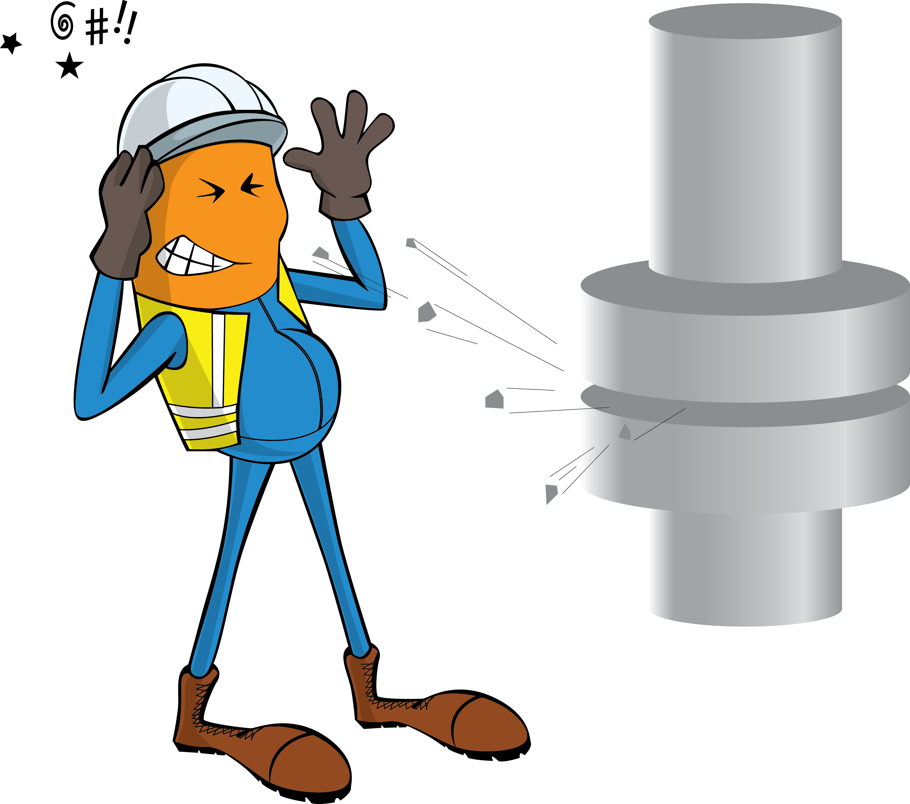
PDO Incident First Alert
Incident Type | LTI#33 | Pattern | Released Energy
Date / Time | 19.12.2020 @ 10:30 hrs | Directorate
Location | Qarn Alam | Dept
Target Audience
Operations, Engineering, Drilling
What happened
While three crew members were manipulating a pig launcher for the 16” SRS – CPP Gas line, a release of gas pressure occurred resulting in the Pig coming out of the launcher door striking and injuring two crew members.
Mr. Musleh asks the questions of can it happen to you?
Are you aware of all hazards that are identified for the task you performing?
Do you follow established procedures when breaking into or pressurizing hydrocarbon systems?
Do you follow process safety fundamentals?
Do you always keep away from line of fire?
Please disseminate this LTI notification to your teams and use it in your tool box talks and HSE meetings and notice boards.

