Slide 1
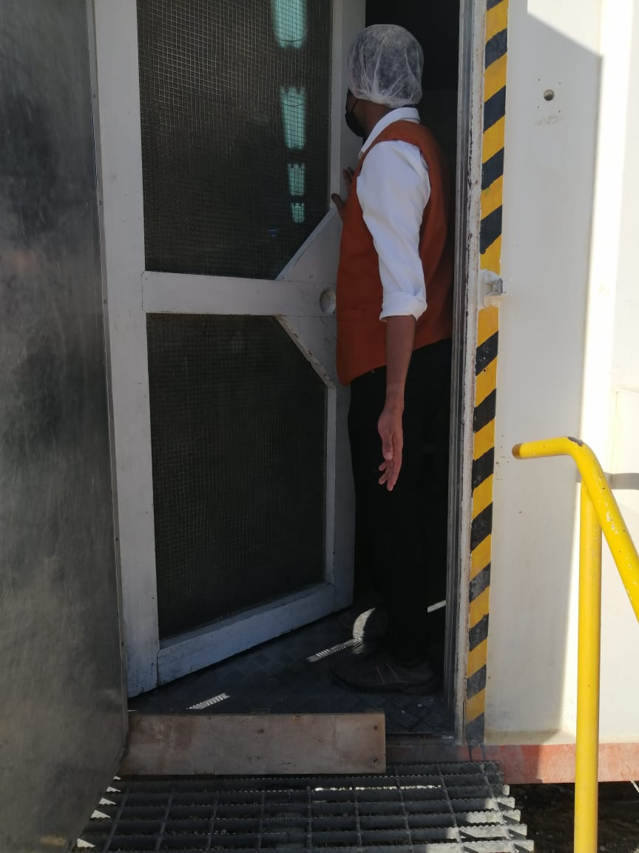
PDO Incident First Alert
Incident Type | LTI#34 | Pattern | Hands & Fingers
Date / Time | 22.12.2020 @ 16:00 hrs | Directorate
Location | Amal | Dept
Target Audience
Operations, Engineering, Drilling, Construction and Logistics
What happened
While entering the kitchen, the waiter has caught his finger in the door resulting in an amputated tip of his left hand index finger.
Mr. Musleh asks the questions of can it happen to you?
Do you consider what could go wrong?
Do you ensure you keep your hands and fingers away from pinch points?
Do you always pay attention while performing a routine activity?
Please disseminate this LTI notification to your teams and use it in your tool box talks and HSE meetings and notice boards.

