Slide 1
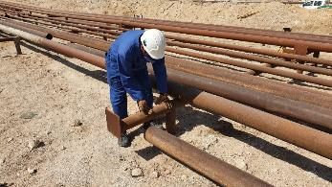
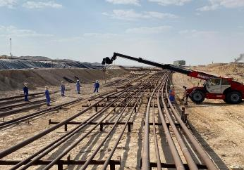
PDO Second Alert
Date: 06.10.2020 Incident title : LTI#26, Finger Injury
What happened?
On 06 Oct. 2020 at 09.00 hrs, a mechanical crew was engaged in shifting pipe on the pipe rack as part of flow line section replacement. To position the pipe on the pipe rack for fit-up, one of the riggers in the crew pushed the pipe from one end while others were pulling it from the opposite end. During this course of action the pipe end slipped from the support and rigger’s left hand middle & ring fingers caught between the pipe end and the pipe rack causing avulsion injury and fracture in the finger.
Your learning from this incident..
Always ensure your hands and fingers are away from the “line of fire”
Always comply with manual handling procedure.
Intervene unsafe activities / violations and use your stop empowerment.
Always ensure dynamic risk review whenever there is a change in the work/task.
Shortcuts will cut short safety
Target Audience: Drilling, Logistics, Operation, Engineering & Construction
Notes:
Ensure all dates and titles are input
A short description should be provided without mentioning names of contractors or individuals. You should include, what happened, to who (by job title) and what injuries this resulted in. Nothing more!
Four to five bullet points highlighting the main findings from the investigation. Remember the target audience is the front line staff so this should be written in simple terms in a way that everyone can understand.
The strap line should be the main point you want to get across
The images should be self explanatory, what went wrong (if you create a reconstruction please ensure you do not put people at risk) and below how it should be done.

Slide 2
Management self audit
Date: 06.10.2020 Incident title : LTI#26, Finger Injury
As a learning from this incident and ensure continual improvement all contract
managers must review their HSE HEMP against the questions asked below
Confirm the following:
Do you always ensure senior site management interact regularly with work crews to influence for good HSE behaviour?
Do you always ensure that your employees comply with manual handling procedure?
Do you always ensure that your employees intervene unsafe acts, and exercise their empowerment to stop unsafe work?
Do you always ensure that your employees are aware of the dangers of “Line of Fire”?
Do you always ensure that your employees at supervisory levels demonstrate good supervisory example for those who works under him?
Do you always ensure dynamic risk review is conducted by crew members whenever there is a change in the task in hand?
Do you always ensure right equipment is made available at site for the task/job as planned?
* If the answer is NO to any of the above questions please ensure you take action to correct this finding.
Notes:
Ensure all dates and titles are input
Make a list of closed questions (only ‘yes’ or ‘no’ as an answer) to ask others if they have the same issues based on the management or HSE-MS failings or shortfalls identified in the investigation.
Imagine you have to audit other companies to see if they could have the same issues.
These questions should start with: Do you ensure…………………?

