Slide 1
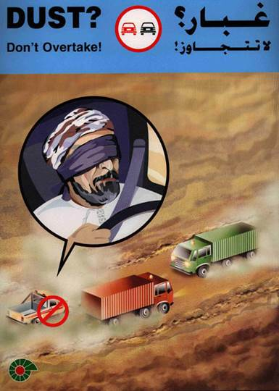
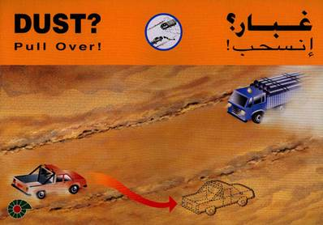
PDO Second Alert
Date: 10.09.2020 Incident title : LTI#20
What happened?
On 10.09.2020 at approximately 11.55hrs. A vehicle with Driver & Passenger were travelling between Qarn Alam to Al Ghubar. They were driving on a graded road, an oncoming vehicle created a dust cloud, this obscured the driver's vision and he failed to reduce speed or notice a sand dune had formed directly in his line of travel. His vehicle drove into and over the sand dune, this caused the vehicle to jump and jerk violently causing minor damage to the vehicle and a minor fracture to the driver’s back.
Your learning from this incident..
Always engage Defensive Driving techniques and slow down when faced with hazards.
Always Pay attention at all times to the conditions of the road ahead.
Always expect the unexpected.
Always understand the hazards of the road and journey before you start.
Always report when physical or other potential hazards have been observed at any point during your journey.
Always drive in accordance with the road / weather conditions.
REMEMBER THE ‘DUST CODE’
GRADED ROAD? - REMEMBER THE ‘DUST CODE’
Target Audience: Drilling, Logistics, Operation, Engineering, Exploration & construction
Notes:
Ensure all dates and titles are input
A short description should be provided without mentioning names of contractors or individuals. You should include, what happened, to who (by job title) and what injuries this resulted in. Nothing more!
Four to five bullet points highlighting the main findings from the investigation. Remember the target audience is the front line staff so this should be written in simple terms in a way that everyone can understand.
The strap line should be the main point you want to get across
The images should be self explanatory, what went wrong (if you create a reconstruction please ensure you do not put people at risk) and below how it should be done.

Slide 2
Management self audit
Date: 10 Sept 2020 MVI Vehicle Impact with Sand Dune on Graded Road
As a learning from this incident and ensure continual improvement all contract
managers must review their HSE HEMP against the questions asked below
Confirm the following:
Do you ensure your drivers are aware of potential hazards on all journies?
Do you ensure that your drivers are aware about the ‘DUST CODE’ in SP 2000 Annex 3?
Do you have a policy that instructs drivers / road users to report any hazards they have observed during their journey?
Do you conduct regular SJM audits?
Do you ensure effective monitoring, compliance and assurance checks are conducted
Do you ensure your employees are aware of the PDO Emergency Contact number, including the pre-fix for GSM’s?
* If the answer is NO to any of the above questions please ensure you take action to correct this finding.
Notes:
Ensure all dates and titles are input
Make a list of closed questions (only ‘yes’ or ‘no’ as an answer) to ask others if they have the same issues based on the management or HSE-MS failings or shortfalls identified in the investigation.
Imagine you have to audit other companies to see if they could have the same issues.
These questions should start with: Do you ensure…………………?

