Slide 1
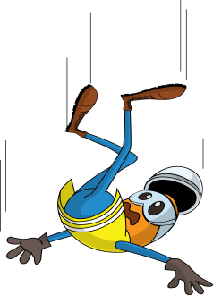
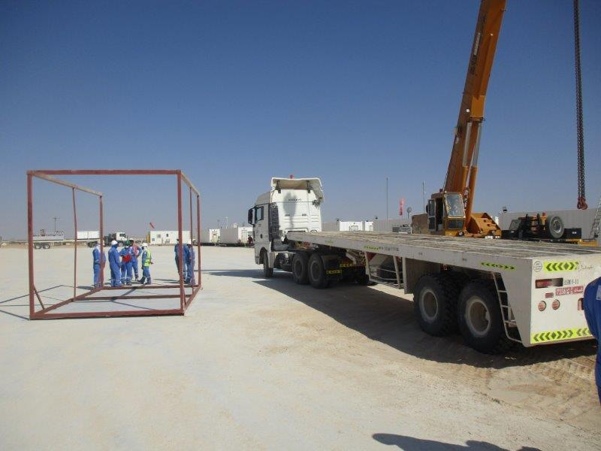
PDO Incident First Alert - Halliburton
Incident Type | LTI#01 | Pattern | Slip, Fall & Trip
Date / Time | 02.01.2021 @ 11:15hrs | Directorate | UWD
Location | Lekhwair | Dept | UWC
Target Audience
Construction, Operations, Logistics, Engineering , Exploration & Drilling
What happened
While the Helper was removing the ratchet straps which secure the ambulance shade on the truck, he lost his balance and jumped from the truck to the same side and away from the fallen ambulance shade , landing on his right hand and fracturing his wrist.
Mr. Musleh asks the questions of can it happen to you?
Do you ensure you identify all hazards before starting a task?
Do you ensure you are in a safe position while performing a task?
Do you consider if you can fall from height?
Do you ensure to intervene and correct unsafe act/condition?
Please disseminate this LTI notification to your teams and use it in your tool box talks and HSE meetings and notice boards.

