Slide 1
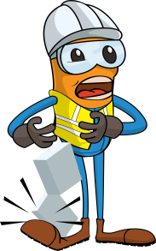
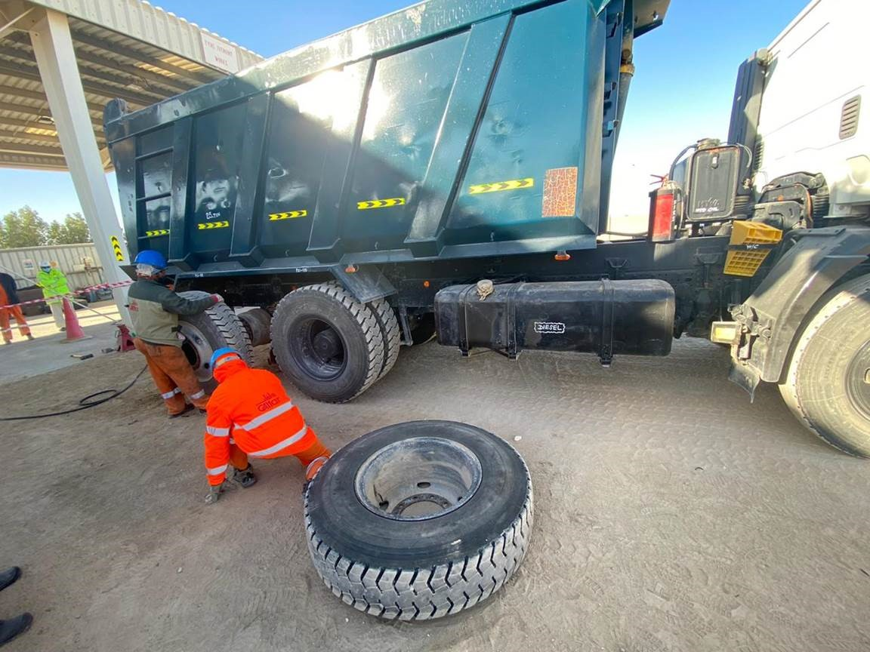
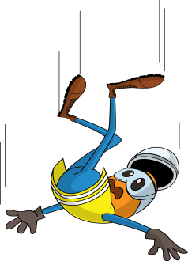
PDO Incident First Alert - Galfar
Incident Type | LTI#02 | Pattern | Struck by
Date / Time | 11.01.2021 @ 15:20hrs | Directorate | Project Delivery
Location | Yibal Khuff Project | Dept | CKC
Target Audience
Construction, Operations, Logistics, Engineering , Exploration & Drilling
What happened
.
During tyre changing process, the driver was standing close to a tipper standby tyre kept in a leaning position ready for fixing when it fell resulting in fractures to the drivers’ right lower leg.
Mr. Musleh asks the questions of can it happen to you?
Do you ensure that you are stood in a safe place?
Do you consider if you are away from “line of fire”?
Do you consider “what could go wrong”?
Do you ensure to intervene and correct unsafe act/condition?
Please disseminate this LTI notification to your teams and use it in your tool box talks and HSE meetings and notice boards.

