Slide 1
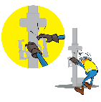


PDO Incident First Alert
Incident Type | LTI#03 | Pattern | Hands and Fingers
Date / Time | 14.01.2021@04:16hrs | Directorate
Location | Nimr | Dept
Target Audience
Drilling, Operations, Engineering & Construction
What happened
While the Floorman was opening the elevator to run tubing, his middle finger was caught between elevator & power tong cylinder causing injury.
Mr. Musleh asks the questions of can it happen to you?
Do you always use the handles provided?
Do you ensure you keep your hands and fingers away from pinch points?
Do you ensure you identify all hazards before starting a task?
Please disseminate this LTI notification to your teams and use it in your tool box talks and HSE meetings and notice boards.
“This document is restricted and it is distributed for information purposes only and it shall not be shared with other than PDO employees and contracts without PDO permission”.

