Slide 1
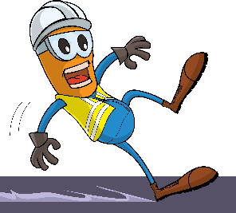
PDO Incident First Alert - PDO
Incident Type | LTI#04 | Pattern | Slip & Fall
Date / Time | 19.01.2021@11:20hrs | Directorate | MD
Location | MAF Clinic | Dept | MCO
Target Audience
Construction, Operations, Logistics, Engineering , Exploration & Drilling
What happened
While the employee was walking towards the offices , he slipped landing on his left hand causing injury to his wrist.
Mr. Musleh asks the questions of can it happen to you?
Do always pay attention to where you are stepping?
Do you ensure you are wearing the correct type of foot wear?
How do you ensure you have safe access and egress?
How do you identify Slip, Trips and fall hazards around your working location?
Please disseminate this LTI notification to your teams and use it in your tool box talks and HSE meetings and notice boards.

