Slide 1
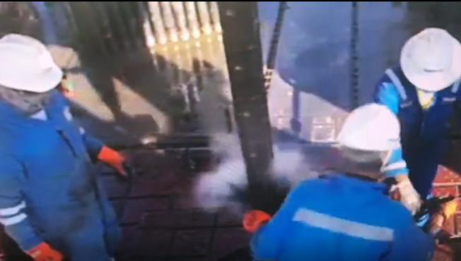
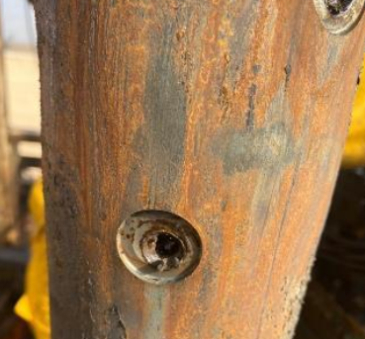
PDO Second Alert
Date: 11.10.2020 Incident title: HiPo#66
What happened?
While carrying a TCP operation in Saqr West-2 on Rig-104, after a successful perforation, the crew started to POOH the BHA, including the fired guns. Crew started to disconnect each gun and laying it down. Once crew had reached the connection between GUN#4 & GUN#3, and after unscrewing the API connection almost fully, dirty brine was released from the lower gun (empty spacer) splashing the 3 persons performing the task. The splash came from the loosen API connection at 360 degrees around the rotary table. No injury to the persons performing the task.
Your learning from this incident..
Always confirm physically for the punctures on the gun carrier.
Always use proper PPE for the task.
Ensure correct leadership is in place before performing a task.
STOP the job if any job condition has changed from the initial job plan.
Ensure all Hazards are discussed and recorded on TRIC card.
Always check physically and confirm the punctures on the gun carrier
Target Audience: Drilling, Logistics & construction
Notes:
Ensure all dates and titles are input
A short description should be provided without mentioning names of contractors or individuals. You should include, what happened, to who (by job title) and what injuries this resulted in. Nothing more!
Four to five bullet points highlighting the main findings from the investigation. Remember the target audience is the front line staff so this should be written in simple terms in a way that everyone can understand.
The strap line should be the main point you want to get across
The images should be self explanatory, what went wrong (if you create a reconstruction please ensure you do not put people at risk) and below how it should be done.

Slide 2
Management Self Audit
Date: 11.10.2020 Incident title: HiPo#66
As a learning from this incident and ensure continual improvement all contract
managers must review their HSE HEMP against the questions asked below
Confirm the following:
Do you ensure that well site leadership visits are being carried regularly?
Do you ensure your crews are empowered to stop any job/task deemed not standard?
Do you ensure review and oversight on your operations base processes?
Do you ensure Management of Change is always followed with any deviation from original plan?
Do you ensure clear communication and job potential hazards discussion with your crew?
* If the answer is NO to any of the above questions please ensure you take action to correct this finding.
Notes:
Ensure all dates and titles are input
Make a list of closed questions (only ‘yes’ or ‘no’ as an answer) to ask others if they have the same issues based on the management or HSE-MS failings or shortfalls identified in the investigation.
Imagine you have to audit other companies to see if they could have the same issues.
These questions should start with: Do you ensure…………………?

