Slide 1
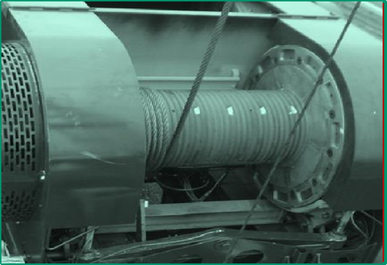
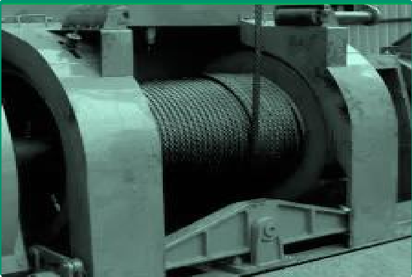
PDO Second Alert
Date: 29.10.2020 Incident title: HiPo#67
What happened?
At 9:00am after major maintenance and inspection of travelling block and replacement of drill line, Rig Tool pusher and driller were reeving the new drill line into the draw work drum. While scooping out the mast they were continuously lowering the travelling block keeping it at 4 meters height. After upper section of mast was fully scooped out the locking pins of mast were engaged where travelling block was at height of 6 mtr with 33 wraps left on draw work. The driller then started lowering the (5 ton) traveling block from a height of 6 mtr. to rig floor level. When the block reached height of 0.5 mtr from the rig floor, it continued to descend and finally leaned down and rested on the Rig floor. The fast line disconnected from the clamp and came down to the rig floor from the fast line sheave.
Your learning from this incident..
Always ensure you follow the SOP while doing the task.
Always ensure you maintain Drops Zone management.
Always ensure supervisor is supervising the job and not doing the job.
Always ensure that drill line provided with visible identification (marked) and engineering controls.
Always ensure you stop the work before exceeding minimum wraps or any other equipment limitation.
Always ensure minimum wraps maintained on draw work as per OEM requirement & SOP
Target Audience: Drilling, Logistics & construction
Notes:
Ensure all dates and titles are input
A short description should be provided without mentioning names of contractors or individuals. You should include, what happened, to who (by job title) and what injuries this resulted in. Nothing more!
Four to five bullet points highlighting the main findings from the investigation. Remember the target audience is the front line staff so this should be written in simple terms in a way that everyone can understand.
The strap line should be the main point you want to get across
The images should be self explanatory, what went wrong (if you create a reconstruction please ensure you do not put people at risk) and below how it should be done.

Slide 2
Management self audit
Date: 29.10.2020 Incident title: HiPo#67
As a learning from this incident and ensure continual improvement all contract
managers must review their HSE HEMP against the questions asked below
Confirm the following:
Do you ensure that SOP is updated and capturing OEM and industrial requirements?
Do you ensure that SOPs are effectively implemented?
Do you ensure that learning from Incident is effectively communicated and understood?
Do you ensure that empowerment to stop is used?
Do you ensure that supervisors are supervising and not doing the job themselves?
Do you ensure that all critical tasks are supervised by competent supervisors?
* If the answer is NO to any of the above questions please ensure you take action to correct this finding.
Notes:
Ensure all dates and titles are input
Make a list of closed questions (only ‘yes’ or ‘no’ as an answer) to ask others if they have the same issues based on the management or HSE-MS failings or shortfalls identified in the investigation.
Imagine you have to audit other companies to see if they could have the same issues.
These questions should start with: Do you ensure…………………?

