Slide 1
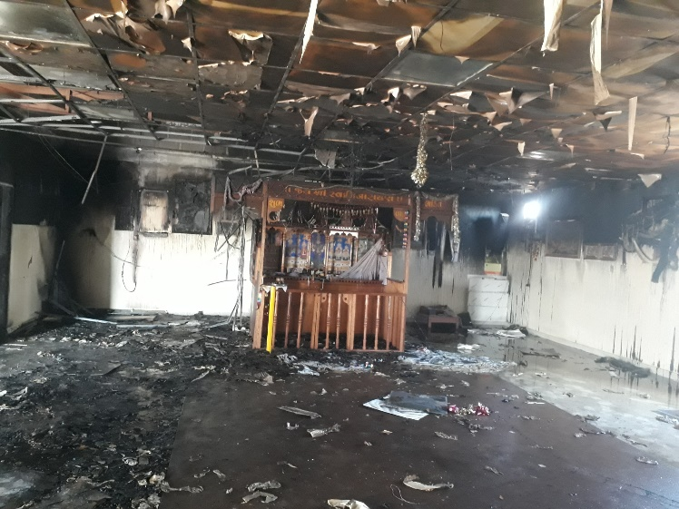
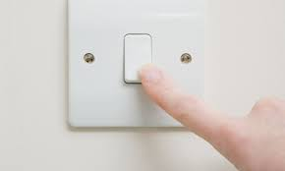
PDO Second Alert
Date: 14.11.2020 Incident title: HiPo#72
What happened?
On 14th November 2020 at around 0325 hrs. an employee, while walking towards the common ablution heard smoke detector alarm and saw smoke coming out from the Temple. He immediately alerted camp boss. Camp boss reached the spot and found it difficult to extinguish the fire because of the dense smoke. Informed PDO emergency number and requested services of fire brigade. Fire brigade reached camp and extinguished fire.
Your learning from this incident..
Always report burning odors to maintenance teams immediately.
Always ensure electrical appliances are switched OFF before leaving the room.
Always do periodic checks on electrical appliances. Including inspections and maintenance.
Always ensure combustible materials are stored away from any ignition source.
Always install electrical appliances as per the standards.
SWITCH OFF WHEN LEAVING A ROOM
Make sure no switches are ON, before you leave
Target Audience: Drilling, Logistics & construction
Notes:
Ensure all dates and titles are input
A short description should be provided without mentioning names of contractors or individuals. You should include, what happened, to who (by job title) and what injuries this resulted in. Nothing more!
Four to five bullet points highlighting the main findings from the investigation. Remember the target audience is the front line staff so this should be written in simple terms in a way that everyone can understand.
The strap line should be the main point you want to get across
The images should be self explanatory, what went wrong (if you create a reconstruction please ensure you do not put people at risk) and below how it should be done.

Slide 2
Management self audit
Date: 14.11.2020 Incident title: HiPo#72
As a learning from this incident and ensure continual improvement all contract
managers must review their HSE HEMP against the questions asked below
Confirm the following:
Do you ensure management teams understand escalation procedures?
Do you ensure that periodic checks are being done on electricals appliances ?
Do you ensure that electrical appliances are switched off when leaving the rooms ?
Do you ensure that personnel are sensitized about taking action on warning signs ?
Do you ensure all your facilities are covered in inspections and audits?
* If the answer is NO to any of the above questions please ensure you take action to correct this finding.
Notes:
Ensure all dates and titles are input
Make a list of closed questions (only ‘yes’ or ‘no’ as an answer) to ask others if they have the same issues based on the management or HSE-MS failings or shortfalls identified in the investigation.
Imagine you have to audit other companies to see if they could have the same issues.
These questions should start with: Do you ensure…………………?

