Slide 1
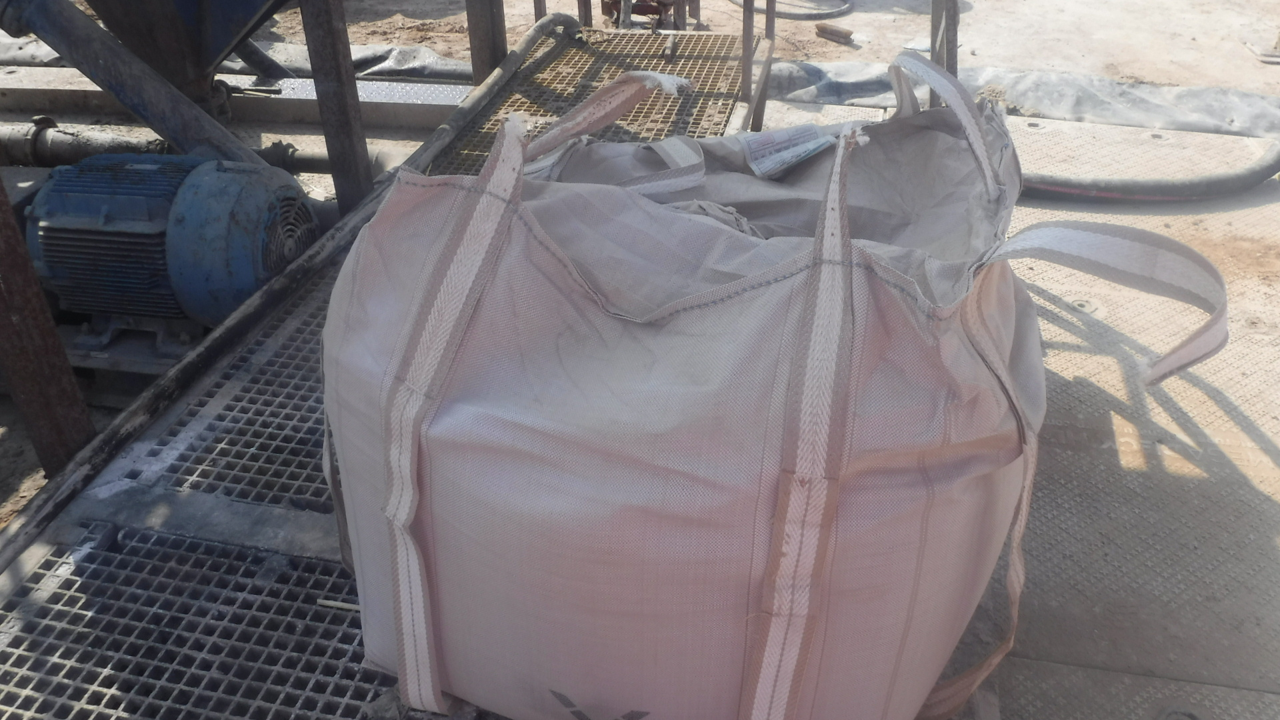
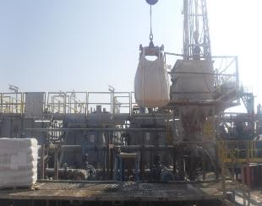
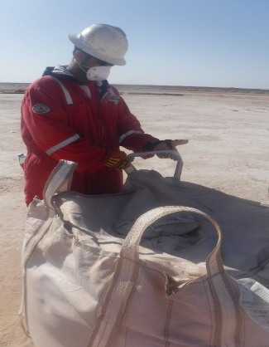
PDO Second Alert
Date: 13.11.2020 Incident title: HiPo#73
What happened?
On 13th of November 2020 after TBT meeting and visual inspection of the chemical bags by crew members, mixing chemical at hopper area started. The lifting was initiated by using 4 leg chemical Bag lifter. Crane operator started lifting the chemical bag towards the hopper. Once the bag reached around 2.5 meter height beside the hopper its fell down and landed at the mixing platform . Temporary No go zone was managed and no one was in the area.
Your learning from this incident..
Always adhere to No go zone while handling bulk bags.
Ensure to have enough tarpaulin to cover all bags.
Ensure to have tracking sheet of all chemicals to make sure first in first out.
Always Adhere to No Go zone while mixing Bulk bags
Target Audience: Drilling, Operations, Logistics, Engineering & Construction
Notes:
Ensure all dates and titles are input
A short description should be provided without mentioning names of contractors or individuals. You should include, what happened, to who (by job title) and what injuries this resulted in. Nothing more!
Four to five bullet points highlighting the main findings from the investigation. Remember the target audience is the front line staff so this should be written in simple terms in a way that everyone can understand.
The strap line should be the main point you want to get across
The images should be self explanatory, what went wrong (if you create a reconstruction please ensure you do not put people at risk) and below how it should be done.

Slide 2
Management self audit
Date: 13.11.2020 Incident title: HiPo#73
As a learning from this incident and ensure continual improvement all contract
managers must review their HSE HEMP against the questions asked below
Confirm the following:
Do you ensure that the chemical bags are kept covered by tarpaulin ?
Do you ensure that FIFO system is applied in chemical bag storage yard?
Do you ensure to have a tracking sheet for the chemicals bags at the rig site ?
Do you enforce temporary no go zone management?
* If the answer is NO to any of the above questions please ensure you take action to correct this finding.
Notes:
Ensure all dates and titles are input
Make a list of closed questions (only ‘yes’ or ‘no’ as an answer) to ask others if they have the same issues based on the management or HSE-MS failings or shortfalls identified in the investigation.
Imagine you have to audit other companies to see if they could have the same issues.
These questions should start with: Do you ensure…………………?

