Slide 1
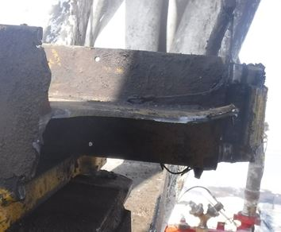
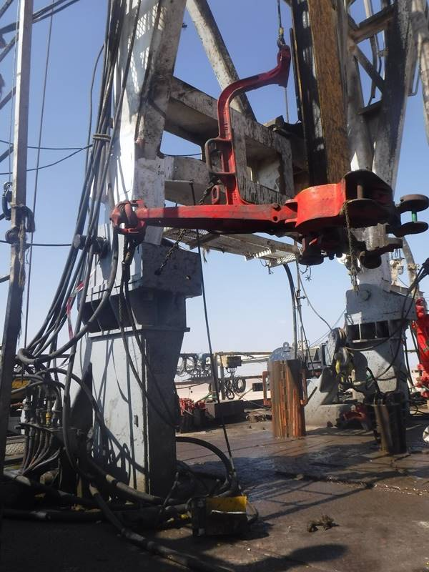
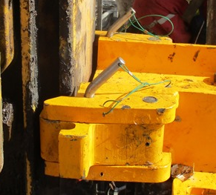
PDO Second Alert
Failure point
Tie back 18 KG dropping point
Date: 17.11.2020 Incident title: HiPo#74
What happened?
While back reaming on 12 ¼’’ section with erratic torque and vibration, a piece from the lower tie back broke and dropped from the mast beam from height of 3 meters, weighing 18 Kg landing on the rig floor. Driller immediately stopped rotation and informed rig manger and DSV. Red zone was fully managed.
Your learning from this incident..
Ensure red zone is managed at all times.
During drops inspection, check that there are no holes drilled in main beam structure.
Check all NOV lower tie back for similar issue.
Stop back reaming if excessive torque or vibration and report to TP and DSV.
Always adhere to red zone management
Target Audience: Drilling, Operations, Logistics, Engineering & Construction
Notes:
Ensure all dates and titles are input
A short description should be provided without mentioning names of contractors or individuals. You should include, what happened, to who (by job title) and what injuries this resulted in. Nothing more!
Four to five bullet points highlighting the main findings from the investigation. Remember the target audience is the front line staff so this should be written in simple terms in a way that everyone can understand.
The strap line should be the main point you want to get across
The images should be self explanatory, what went wrong (if you create a reconstruction please ensure you do not put people at risk) and below how it should be done.

Slide 2
Management self audit
Date: 17.11.2020 Incident title: HiPo#74
As a learning from this incident and ensure continual improvement all contract
managers must review their HSE HEMP against the questions asked below
Confirm the following:
Do you ensure all OEM PIB are received, documented and implemented?
Do you ensure red zone management is well enforced?
Do you ensure that all potential drop objects are covered in weekly drop inspection checklist?
Do you ensure that third party conduct risk assessment of secondary retention attachments?
* If the answer is NO to any of the above questions please ensure you take action to correct this finding.
Notes:
Ensure all dates and titles are input
Make a list of closed questions (only ‘yes’ or ‘no’ as an answer) to ask others if they have the same issues based on the management or HSE-MS failings or shortfalls identified in the investigation.
Imagine you have to audit other companies to see if they could have the same issues.
These questions should start with: Do you ensure…………………?

