Slide 1
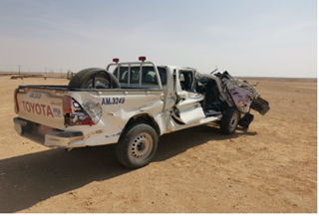
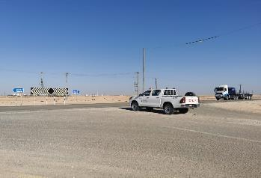
PDO Second Alert
Date: 19.11.2020 Incident title: HiPo#75
What happened?
At 10:47 Hrs, Nov 19, 2020, an incident occurred between two vehicles. The pick-up driven by assistant operator who was joining Rima – Haima road at a wrong angle next to Jalmood junction, collided on the side of the trailer, resulted in the pick-up being dragged for 190m until came up to a halt. The accident caused severe damage to the pick-up, no damage to the trailer and no injuries to personnel.
Your learning from this incident..
Always keep your attention on the road while driving.
Always have a proper lookout for other traffic & road users.
Always use defensive driving techniques, avoid using shortcuts.
Always Obey all posted signage.
Always intervene for unsafe action.
Driver must be stopped at T - junction
Always follow road traffic regulations & Stop at T- junction
Target Audience: Drilling, Operations, Logistics, Exploration, Engineering & Construction
Notes:
Ensure all dates and titles are input
A short description should be provided without mentioning names of contractors or individuals. You should include, what happened, to who (by job title) and what injuries this resulted in. Nothing more!
Four to five bullet points highlighting the main findings from the investigation. Remember the target audience is the front line staff so this should be written in simple terms in a way that everyone can understand.
The strap line should be the main point you want to get across
The images should be self explanatory, what went wrong (if you create a reconstruction please ensure you do not put people at risk) and below how it should be done.

Slide 2
Management self audit
Date: 19.11.2020 Incident title: HiPo#75
As a learning from this incident and ensure continual improvement all contract
managers must review their HSE HEMP against the questions asked below
Confirm the following:
Do you ensure that the road is free of vehicles movements before crossing the road?
Do you ensure that drivers are following the road traffic regulations?
Do you ensure that the learning from incidents are cascaded to end users?
Do you ensure that employees are aware of INTERVENE?
Do you ensure hazards presented by 3rd party vehicles are communicated to drivers on a regular basis?
Do you ensure driver behaviour is effectively monitored?
Do you ensure driver comply to journey plan path?
* If the answer is NO to any of the above questions please ensure you take action to correct this finding.
Notes:
Ensure all dates and titles are input
Make a list of closed questions (only ‘yes’ or ‘no’ as an answer) to ask others if they have the same issues based on the management or HSE-MS failings or shortfalls identified in the investigation.
Imagine you have to audit other companies to see if they could have the same issues.
These questions should start with: Do you ensure…………………?

