Slide 1
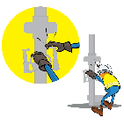
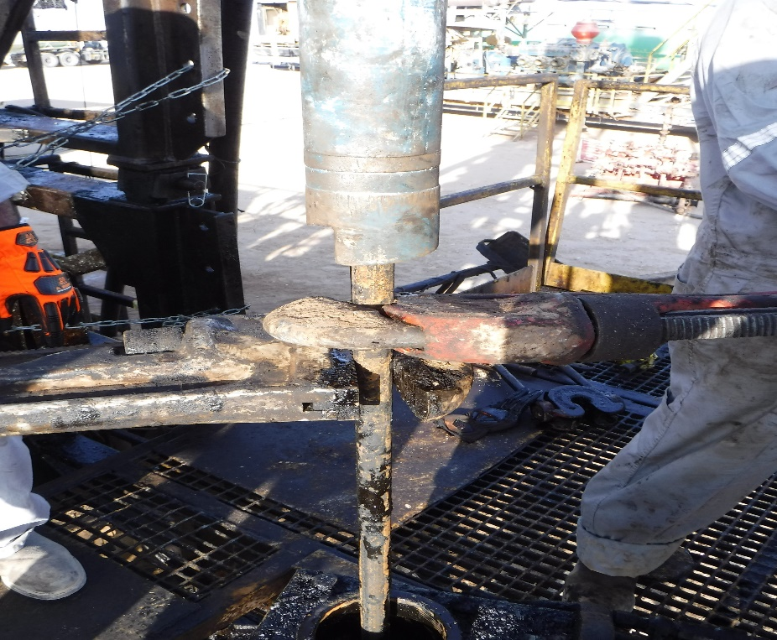


PDO Incident First Alert - Petrogas Rima
Incident Type | LTI#06 | Pattern | Release Energy
Date / Time | 13.02.2021@14:55hrs | Directorate | OSD
Location | Bahja | Dept | OSP
Target Audience
Drilling, Operations, Engineering, Logistic & Construction
What happened
While using pipe wrenches to back off the Co-rod, one of the pipe wrench slipped striking the derrickman’s arm causing a fracture to his right elbow.
Mr. Musleh asks the questions of can it happen to you?
Do you consider what could go wrong?
Do you consider if you are away from ‘line of fire’ released energy?
Do you ensure you identify all hazards before starting a task?
Please disseminate this LTI notification to your teams and use it in your tool box talks and HSE meetings and notice boards.
“This document is restricted and it is distributed for information purposes only and it shall not be shared with other than PDO employees and contracts without PDO permission”.

