Slide 1
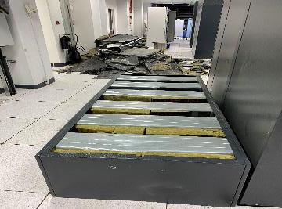
PDO Second Alert
Date: 07.07.2020 Incident title: HiPo#52
What happened?
The Oxygen Reduction gas based fire suppression system, released Nitrogen gas (full force with cylinders) inside the data center. The nitrogen gas released with big burst causing multiple damage to ceiling and data storage equipment. The fire tender was called (by the data center operator) and after thorough checks they did not find any fire related alarms.
Your learning from this incident..
Always ensure formal notice given to emergency services when disabling alarms.
Always ensure maintenance and design records are maintained and available.
Always ensure the Risk assessment covers all eventualities.
Ensure all relevant parties are involved
Target Audience: Drilling, Logistics & construction
Notes:
Ensure all dates and titles are input
A short description should be provided without mentioning names of contractors or individuals. You should include, what happened, to who (by job title) and what injuries this resulted in. Nothing more!
Four to five bullet points highlighting the main findings from the investigation. Remember the target audience is the front line staff so this should be written in simple terms in a way that everyone can understand.
The strap line should be the main point you want to get across
The images should be self explanatory, what went wrong (if you create a reconstruction please ensure you do not put people at risk) and below how it should be done.

Slide 2
Management self audit
Date: 07.07.2020 Incident title: HiPo#52
As a learning from this incident and ensure continual improvement all contract
managers must review their HSE HEMP against the questions asked below
Confirm the following:
Do you ensure that all stake holders are involved in the Risk assessments for Data center maintenance activities?
Do you ensure that formal communication with emergency services is included in the maintenance plan as well as emergency response plan?
Do you ensure that mitigation is in place for any activities that could affect the Data center integrity?
Do you ensure that records and plans are available during staff turnover?
* If the answer is NO to any of the above questions please ensure you take action to correct this finding.
Notes:
Ensure all dates and titles are input
Make a list of closed questions (only ‘yes’ or ‘no’ as an answer) to ask others if they have the same issues based on the management or HSE-MS failings or shortfalls identified in the investigation.
Imagine you have to audit other companies to see if they could have the same issues.
These questions should start with: Do you ensure…………………?

