Slide 1
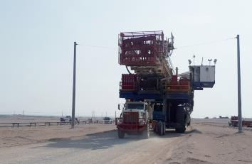
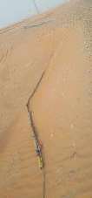
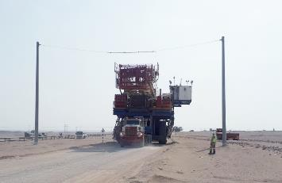
PDO Second Alert
Date: 11.08.20 Incident Title: HiPo#55
What happened?
Whilst moving a rig convoy , the truck with the mast carrier was passing under the overhead line (after the first kicker board). The RMS asked the driver to stop so he could control the rest of the convoy, however the driver carried on driving and the mast struck the 2nd kicker board, pulling the kicker board line and one of the goal posts down. No injuries were sustained
Your learning from this incident..
Always ensure that all your staff are fully briefed on the route survey.
Always ensure that all your Drivers have a coloured copy of the route survey.
Always ensure the Route Survey is valid (Not more than 7 days prior to move).
RMS / ARMS / Drivers and others.
Always ensure there are sufficient number of supervisors to control operations.
Always ensure you report any discrepancies with the route survey to your supervisor/manager.
Always ensure you have a coloured copy of the route survey.
Always ensure you have been briefed on the route survey.
Always ensure you use your empowerment to STOP where required.
Always ensure you do not move vehicles or other equipment without the proper authority.
Always ensure you stop work if you do not have adequate supervision.
Follow instructions from your supervisor
Target Audience: Drilling, Logistics
Notes:
Ensure all dates and titles are input
A short description should be provided without mentioning names of contractors or individuals. You should include, what happened, to who (by job title) and what injuries this resulted in. Nothing more!
Four to five bullet points highlighting the main findings from the investigation. Remember the target audience is the front line staff so this should be written in simple terms in a way that everyone can understand.
The strap line should be the main point you want to get across
The images should be self explanatory, what went wrong (if you create a reconstruction please ensure you do not put people at risk) and below how it should be done.

Slide 2
Management self audit
Date: 11.08.20 Incident title HiPo # 55
As a learning from this incident and ensure continual improvement all contract
managers must review their HSE HEMP against the questions asked below
Confirm the following:
Do you ensure that route surveys are rechecked following adverse weather?
Do you ensure the correct number of supervisors are available for tasks being conducted?
Do you ensure all drivers involved in the Rig move are briefed on and receive a copy of the route survey?
Do you ensure that the correct verification checks are carried out on route surveys?
Do you ensure route surveys are re-checked after the 7 day expiration?
Do you ensure you conduct adequate on site verification / assurance visits?
Do you ensure actions are closed and sustained from previous incidents?
Do you ensure that you / supervisory staff use the IHTIMAM process to capture bad / good behaviours during the rig move?
* If the answer is NO to any of the above questions please ensure you take action to correct this finding.
Notes:
Ensure all dates and titles are input
Make a list of closed questions (only ‘yes’ or ‘no’ as an answer) to ask others if they have the same issues based on the management or HSE-MS failings or shortfalls identified in the investigation.
Imagine you have to audit other companies to see if they could have the same issues.
These questions should start with: Do you ensure…………………?

