Slide 1
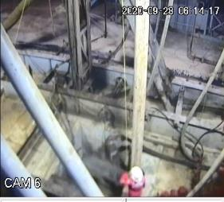
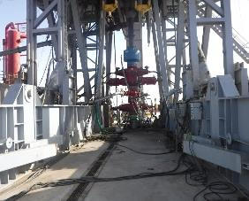
PDO Second Alert
Date: 28.09.2020 Incident Title: HiPo#64
What happened?
While running in hole 13-3/8” shoe track, Driller noticed a sudden hold up happened. He suspected that the edge of float shoe was hooked up inside conductor shoe. Due to this DSV and NTP decided to pull the float shoe to rig floor for checking the condition. As the casing shoe was coming through the slips it caught slip segment, After inspecting the shoe and RIH casing Floor-man noticed that segment had moved from carrier position and informed driller to stop. TBT was held on removing and replacing slip segment. While repositioning segment it dropped to Cellar. No one injured.
Your learning from this incident..
Always ensure the risk assessment is applied for any none routine activity.
Always ensure to adhere with red zone, No go zone management.
Always ensure that no one standing in the line of fire.
Always keep good communication between the crew members.
Always ensure effective TBT conducted and ensure all hazards are briefed to all & understood.
Ensure employees have left no go zone and barriers are installed prior to continuing the task
Target Audience: Drilling
Notes:
Ensure all dates and titles are input
A short description should be provided without mentioning names of contractors or individuals. You should include, what happened, to who (by job title) and what injuries this resulted in. Nothing more!
Four to five bullet points highlighting the main findings from the investigation. Remember the target audience is the front line staff so this should be written in simple terms in a way that everyone can understand.
The strap line should be the main point you want to get across
The images should be self explanatory, what went wrong (if you create a reconstruction please ensure you do not put people at risk) and below how it should be done.

Slide 2
Management self audit
Date: 28.09.2020 Incident Title: HiPo#64
As a learning from this Near Miss and ensure continual improvement all contract
managers must review their HSE HEMP against the questions asked below
Confirm the following:
Do you ensure effective TBT conducted with the team and all hazard are mitigated as much as possible?
Do you ensure that OEM design id risk assessed before being used ?
Do you ensure full inspection of equipment prior to use?
Do you ensure all components of handling equipment are captured during inspections?
Do ensure safety devices of equipment are fully functional?
Do you ensure the full implementation of zone management?
* If the answer is NO to any of the above questions please ensure you take action to correct this finding.
Notes:
Ensure all dates and titles are input
Make a list of closed questions (only ‘yes’ or ‘no’ as an answer) to ask others if they have the same issues based on the management or HSE-MS failings or shortfalls identified in the investigation.
Imagine you have to audit other companies to see if they could have the same issues.
These questions should start with: Do you ensure…………………?

