Slide 1
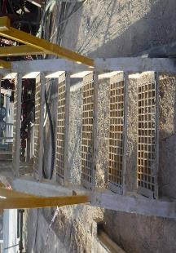
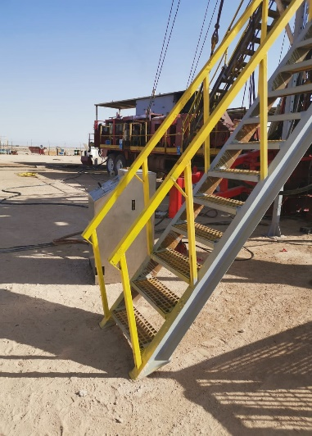
PDO Second Alert
Date:17.09.2020 Incident title: LTI#23, Ankle Injury
What happened?
During BOP drill, while coming down from rig floor to Natih manifold through the stair, Derrick man right ankle twisted at the ground level. Once drill completed, derrick man complained about the pain in his right ankle. Derrick man was transferred to PDO Fahud clinic where Doctor examined him and referred him to Nizwa Hospital for X-Ray and further investigation.
Your learning from this incident..
Always ensure hand rail covers all the steps.
Always watch your steps during climbing or descending stairs.
Always maintain three point contact while using stairs.
Always report deficiency in design or damage of handrails or steps.
Always do not rush during drills.
Watch your steps and do not rush during drills. Always use three point contact.
Target Audience: Drilling, Logistics, Operation, Engineering & Construction
Notes:
Ensure all dates and titles are input
A short description should be provided without mentioning names of contractors or individuals. You should include, what happened, to who (by job title) and what injuries this resulted in. Nothing more!
Four to five bullet points highlighting the main findings from the investigation. Remember the target audience is the front line staff so this should be written in simple terms in a way that everyone can understand.
The strap line should be the main point you want to get across
The images should be self explanatory, what went wrong (if you create a reconstruction please ensure you do not put people at risk) and below how it should be done.

Slide 2
Management self audit
Date:17.09.2020 Incident title: LTI#23, Ankle Injury
As a learning from this incident and ensure continual improvement all contract
managers must review their HSE HEMP against the questions asked below
Confirm the following:
1. Do you ensure that stairways meet OSHA standard – 1910.25?
2. Do you regularly inspect condition of stairways prior to spud / after rig move?
3. Do you ensure that drills are conducted safely and not rushed?
4. Do you ensure that appropriate feedback is provided to crew after drill?
* If the answer is NO to any of the above questions please ensure you take action to correct this finding.
Notes:
Ensure all dates and titles are input
Make a list of closed questions (only ‘yes’ or ‘no’ as an answer) to ask others if they have the same issues based on the management or HSE-MS failings or shortfalls identified in the investigation.
Imagine you have to audit other companies to see if they could have the same issues.
These questions should start with: Do you ensure…………………?

