Slide 1
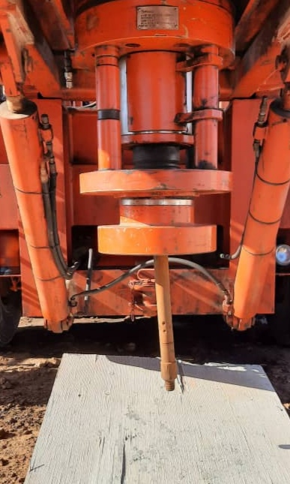
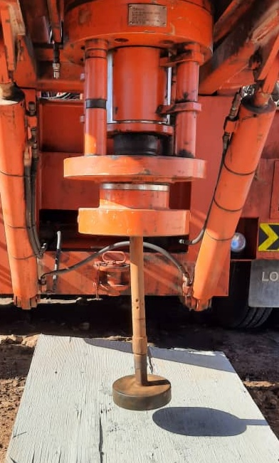
PDO Second Alert
Date: 29.11.2020 Incident Title: Hipo#77
What happened?
At 15:03 hrs , injector head was lifted on air to remove the riser, while injector was suspended on air Coiled Tubing pipe came off the injector goose neck and fall on the ground, the red zone area well managed and no injury happened.
Your learning from this incident..
Always ensure second barrier ( No Go ) must be in place incase of human error occurred
Always ensure the stack height to be calculated before rig up operation
Always ensure to have the updated standards and procedures at the site
Always ensure to use the HEMP to identify specific task hazards
Always ensure safety barrier No Go are in place
Target Audience: Drilling
Notes:
Ensure all dates and titles are input
A short description should be provided without mentioning names of contractors or individuals. You should include, what happened, to who (by job title) and what injuries this resulted in. Nothing more!
Four to five bullet points highlighting the main findings from the investigation. Remember the target audience is the front line staff so this should be written in simple terms in a way that everyone can understand.
The strap line should be the main point you want to get across
The images should be self explanatory, what went wrong (if you create a reconstruction please ensure you do not put people at risk) and below how it should be done.

Slide 2
Management self audit
Date: 29.11.2020 Incident Title: Hipo#77
As a learning from this incident and ensure continual improvement all contract
managers must review their HSE HEMP against the questions asked below
Confirm the following:
Do you ensure that HEMP is reviewed and put additional controls?
Do you ensure qualified and competent crew at site?
Do you ensure NO-GO ( barrier ) installed on the ground?
Do you ensure injector stands are provided for support the injector on the ground to install No-GO?
Do you ensure site audit are conducted by management to review the risk involved during rig up procedure (SOP)?
Do you ensure competency assessment is done and gaps are identified?
Do you ensure to use updated procedures and standard and covering all activities?
* If the answer is NO to any of the above questions please ensure you take action to correct this finding.
Notes:
Ensure all dates and titles are input
Make a list of closed questions (only ‘yes’ or ‘no’ as an answer) to ask others if they have the same issues based on the management or HSE-MS failings or shortfalls identified in the investigation.
Imagine you have to audit other companies to see if they could have the same issues.
These questions should start with: Do you ensure…………………?

