Slide 1
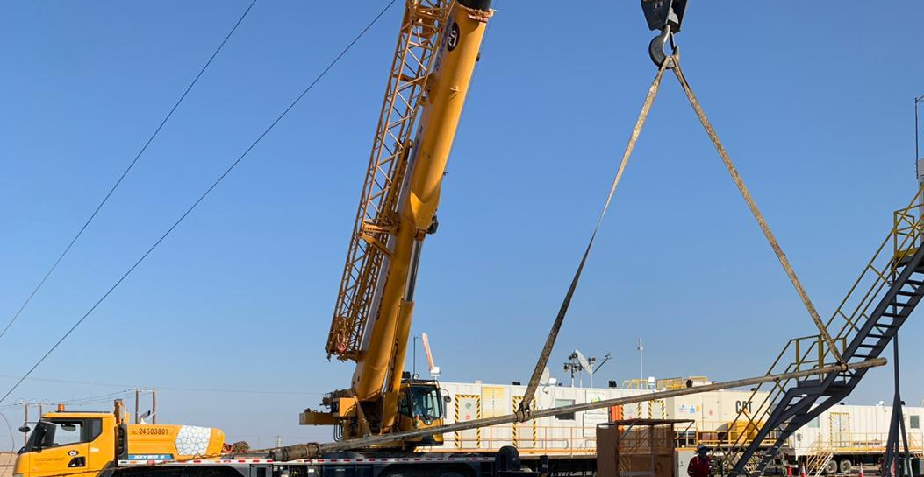
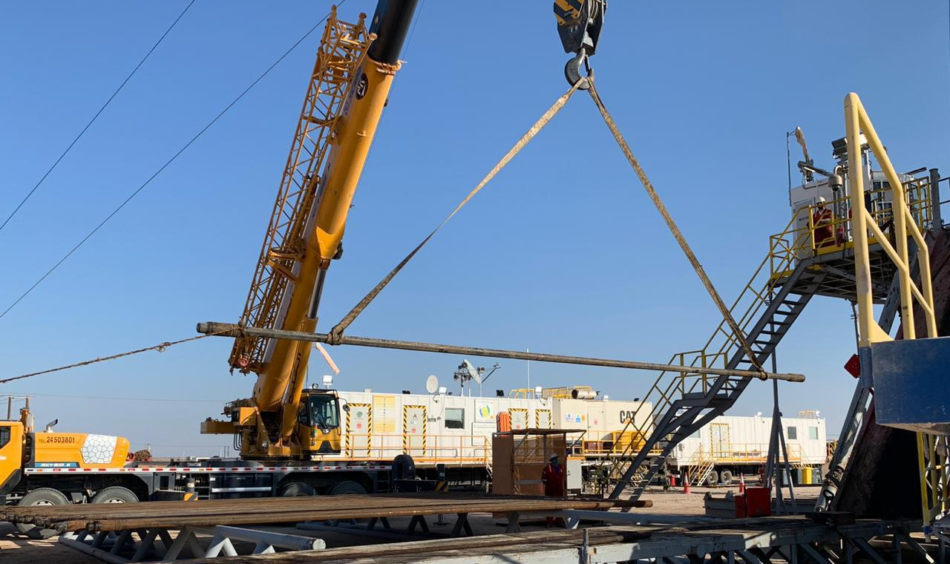
PDO Second Alert
Date: 06.11.2020 Incident Title: HVL#19
What happened?
During lay down 3.1/2" DP from rig floor to catwalk by using mobile crane and two web slings. The lifted pipe was not in balance position (lower web sling was not in right position) as a result lower web sling slip up and the DP joint moved to vertical position through V-door and hanged by crane. “Temporary No Go Zone” was well managed and No body injured.
Your learning from this incident..
Always ensure to adhere with red zone, No go zone management.
Always ensure that no one standing in the line of fire.
Always ensure Rigging method are done properly before lifting tubulars.
Always do not open elevator before making sure it is free of any load.
Always ensure lift plan is in place and followed.
Always ensure Rigging method are done properly before lifting tubulars
✓
Target Audience: Drilling, Logistics, Operation & construction
Notes:
Ensure all dates and titles are input
A short description should be provided without mentioning names of contractors or individuals. You should include, what happened, to who (by job title) and what injuries this resulted in. Nothing more!
Four to five bullet points highlighting the main findings from the investigation. Remember the target audience is the front line staff so this should be written in simple terms in a way that everyone can understand.
The strap line should be the main point you want to get across
The images should be self explanatory, what went wrong (if you create a reconstruction please ensure you do not put people at risk) and below how it should be done.

Slide 2
Management self audit
Date: 06.11.2020 Incident title: HVL#19
As a learning from this Near Miss and ensure continual improvement all contract
managers must review their HSE HEMP & JSA against the questions asked below
Confirm the following:
Do you ensure that the risk assessment developed for picking up and laying down pipe using crane and web sling eliminate all drop risks?
Do you ensure that no one standing in the line of fire?
Do you ensure that risk can be mitigated by engineering design?
Do you ensure that specific Lift plan for tubular available and followed?
* If the answer is NO to any of the above questions please ensure you take action to correct this finding.
Notes:
Ensure all dates and titles are input
Make a list of closed questions (only ‘yes’ or ‘no’ as an answer) to ask others if they have the same issues based on the management or HSE-MS failings or shortfalls identified in the investigation.
Imagine you have to audit other companies to see if they could have the same issues.
These questions should start with: Do you ensure…………………?

