Slide 1
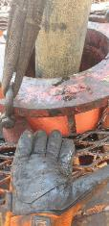
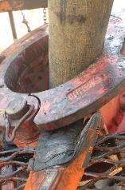
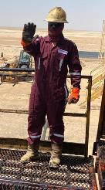
PDO Second Alert
Date:20.09.2020 Incident title: LTI#24, Finger Injury
What happened?
The task of installing the bowl housing was under the supervision of second party PDO Contractor. While installing bowl housing (FREE Equipment) for manual slips (lifted by webbing sling and lowered by winch line), the Fishing Engineer from noticed that the bowl housing was not aligned with the centre of the BOP. The Floorman was in the process of aligning the bowl housing using the webbings sling. The Fishing Engineer stepped forward to align the bowl housing by putting in between the bowl housing and the safety floor. The Fishing Engineer left hand fingers were pinched between the safety floor and the bowl housing. He received a fracture on the 4th phalanx.
Your learning from this incident..
Always do not participate in the job if you are the Supervisor.
Always do not expose your body parts or yourself in the line of Fire.
Always intervene by agreed signal (hand signals or voice command) if necessary.
As Supervisor: Eyes on the task – Hands off!
Target Audience: Drilling, Logistics, Operation, Engineering & Construction
Notes:
Ensure all dates and titles are input
A short description should be provided without mentioning names of contractors or individuals. You should include, what happened, to who (by job title) and what injuries this resulted in. Nothing more!
Four to five bullet points highlighting the main findings from the investigation. Remember the target audience is the front line staff so this should be written in simple terms in a way that everyone can understand.
The strap line should be the main point you want to get across
The images should be self explanatory, what went wrong (if you create a reconstruction please ensure you do not put people at risk) and below how it should be done.

Slide 2
Management self audit
Date:20.09.2020 Incident title: LTI#24, Finger Injury
As a learning from this incident and ensure continual improvement all contract
managers must review their HSE HEMP against the questions asked below
Confirm the following:
Do you ensure that other PDO Contractors lead the Safety Meeting, when the task is under their Supervision?
Do you ensure that all personnel in your company, that Supervise tasks have the FLS training in their Training matrix?
Do you ensure that all your employees in Supervisory role know how to intervene?
Do you ensure that all your employees in Supervisory role know, they shall supervise and not participate in a job?
Do you ensure that you have a controls in your HEMP regulating the roles and responsibilities for work in collaboration with other PDO contractors?
* If the answer is NO to any of the above questions please ensure you take action to correct this finding.
Notes:
Ensure all dates and titles are input
Make a list of closed questions (only ‘yes’ or ‘no’ as an answer) to ask others if they have the same issues based on the management or HSE-MS failings or shortfalls identified in the investigation.
Imagine you have to audit other companies to see if they could have the same issues.
These questions should start with: Do you ensure…………………?

