Slide 1
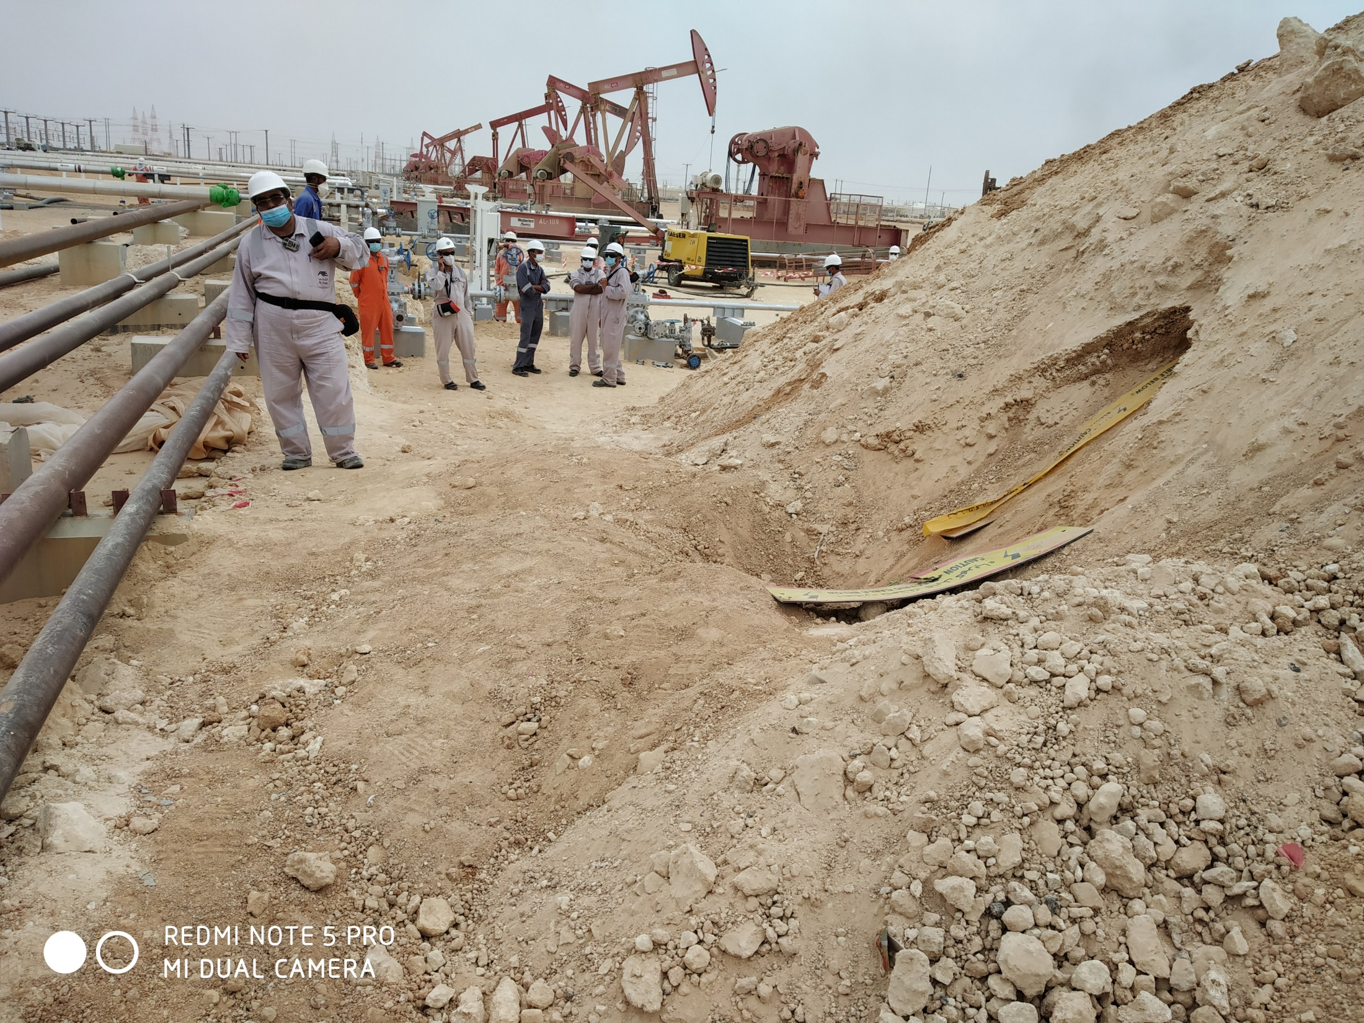
PDO Second Alert
Date: 08.08.2020 Incident title: Hipo#54
What happened?
Civil crew assigned for backfilling activities of an Ethernet cable trench between AL-418 and Al-426. Crew while doing the activity using a Backhoe loader, the loader tooth struck and damaged a live LV Cable feeding supply to well number AL-418.
Your learning from this incident..
Always plan the activity according to site condition
Always comply with the excavation procedure
Always adopt manual excavation near live facilities
Always apply a PTW for the specific activity.
Always communicate with your line management in case of doubt
Always conduct Dynamic Risk Review, if change in work location
Photo explaining what was done wrong
Proper Planning Prevents Poor Performance
Target Audience: Operation, Engineering & Construction
Notes:
Ensure all dates and titles are input
A short description should be provided without mentioning names of contractors or individuals. You should include, what happened, to who (by job title) and what injuries this resulted in. Nothing more!
Four to five bullet points highlighting the main findings from the investigation. Remember the target audience is the front line staff so this should be written in simple terms in a way that everyone can understand.
The strap line should be the main point you want to get across
The images should be self explanatory, what went wrong (if you create a reconstruction please ensure you do not put people at risk) and below how it should be done.

Slide 2
Management self audit
Date: 08.08.2020 Incident title : Hipo#54
As a learning from this incident and ensure continual improvement all contract
managers must review their HSE HEMP against the questions asked below
Confirm the following:
Do your ensure that sufficient instructions are communicated to the work force before commencing work ?
Do you ensure that under ground facilities are identified and protected before using mechanical equipments?
Do you ensure activities are planned and executed accordingly?
Do you ensure that PTW is applied specific for the activity?
Do you ensure that Dynamic risk assessments are conducted?
* If the answer is NO to any of the above questions please ensure you take action to correct this finding.
Notes:
Ensure all dates and titles are input
Make a list of closed questions (only ‘yes’ or ‘no’ as an answer) to ask others if they have the same issues based on the management or HSE-MS failings or shortfalls identified in the investigation.
Imagine you have to audit other companies to see if they could have the same issues.
These questions should start with: Do you ensure…………………?

