Slide 1
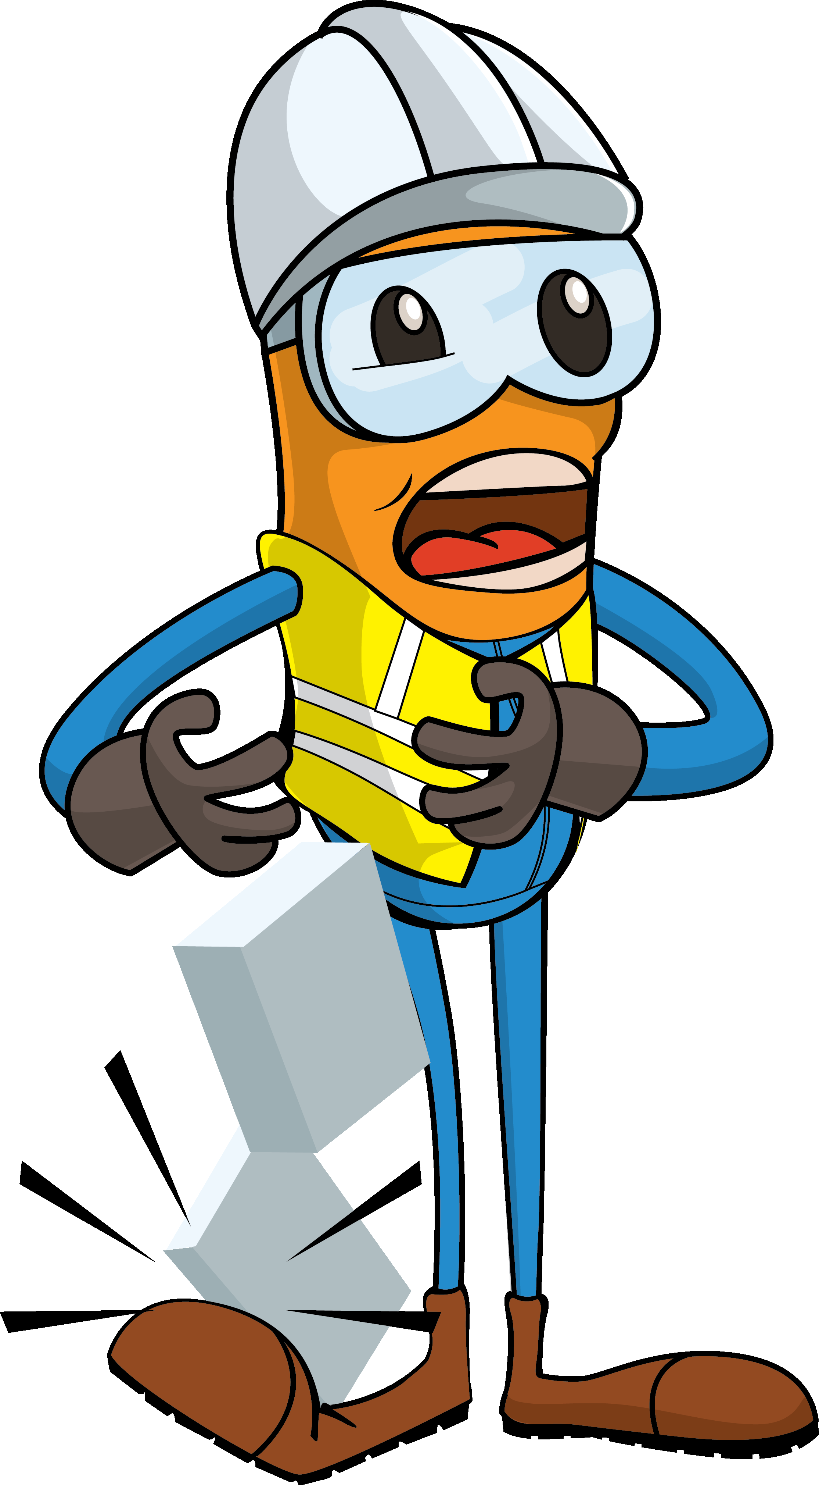
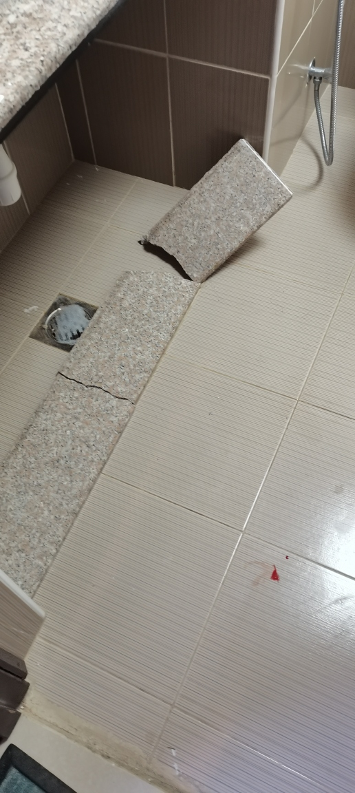
PDO Incident First Alert
Incident Type | LTI#08 | Pattern | Drops
Date / Time | 15.03.2021@06:50hrs | Directorate
Location | Yibal PDO Camp | Dept
Target Audience
Drilling, Operations, Engineering & Construction
What happened
While the production supervisor was completing the ablution in the room, a piece of basin granite broke and fell on the foot resulted in a fracture of left toe.
Mr. Musleh asks the questions of can it happen to you?
Do you ensure you are stood in a safe place?
Do you always report unsafe conditions?
How do you ensure that you are away from ‘Line of Fire’?
How do you ensure you identify all hazards in your surroundings?
Please disseminate this LTI notification to your teams and use it in your tool box talks and HSE meetings and notice boards.
“This document is restricted and it is distributed for information purposes only and it shall not be shared with other than PDO employees and contracts without PDO permission”.

