Slide 1
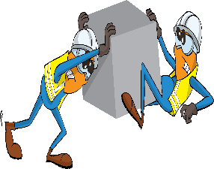
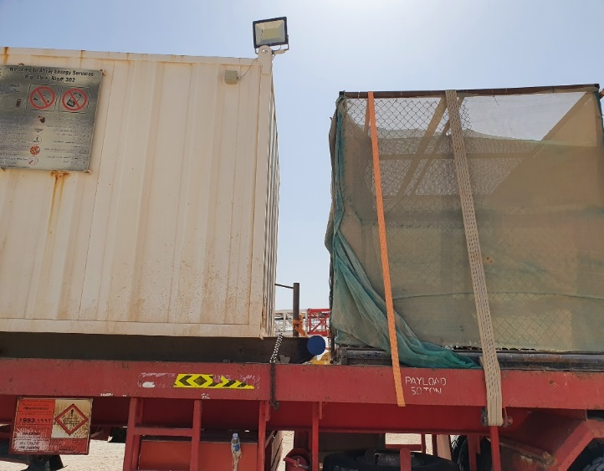
PDO Incident First Alert
Incident Type | LTI#07 | Pattern | Released Energy
Date / Time | 15.03.2021@08:45hrs | Directorate
Location | Rig62- Yibal | Dept
Target Audience
Drilling, Operations, Engineering & Construction
What happened
During loading activity via forklift, while the Helper was standing between a connex (skid type load) and a second skid, a third load was pushed into the 2nd load by the forklift, the helpers legs were struck by the bottom of the skid causing him to fall into the space between.
Mr. Musleh asks the questions of can it happen to you?
How do you ensure you identify all hazards before starting a task?
How do you ensure forklift operators can see you during loading?
Do you consider “what could go wrong?”
Do you consider if you are away from ‘line of fire’ released energy?
Please disseminate this LTI notification to your teams and use it in your tool box talks and HSE meetings and notice boards.
“This document is restricted and it is distributed for information purposes only and it shall not be shared with other than PDO employees and contracts without PDO permission”.

