Slide 1
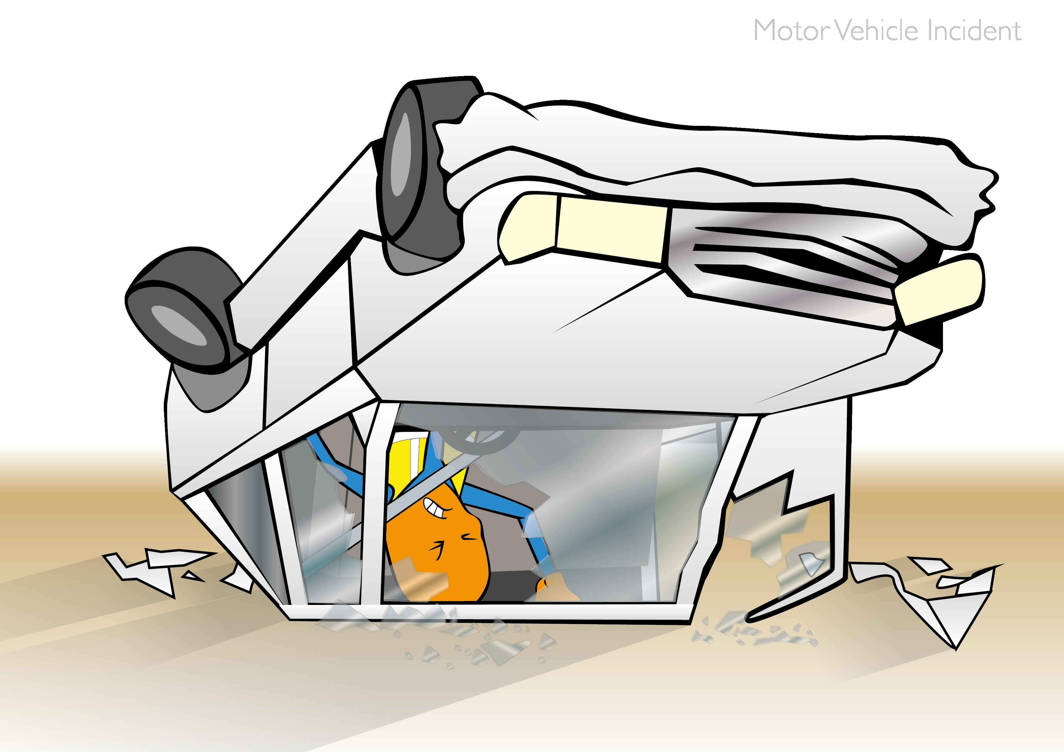
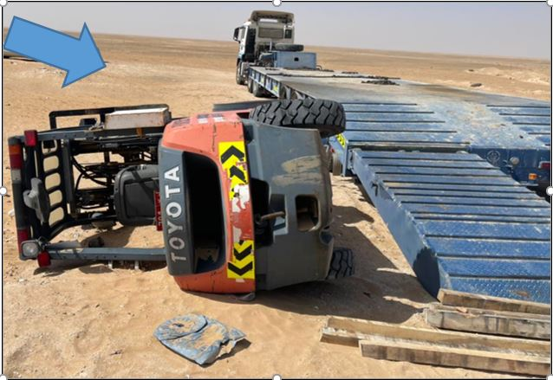
PDO Incident First Alert
Incident Type | LTI#09 | Pattern | MVI
Date / Time | 05.04.2021@13:30hrs | Directorate
Location | Cactus Workshop Yard, Yibal | Dept
Target Audience
Drilling, Operations, Engineering & Construction
What happened
While the Operator was attempting to drive the Forklift on to the trailer, he lost control of the Forklift and it fell off the ramp resulting in foot injury
Mr. Musleh asks the questions of can it happen to you?
Do you ensure you identify all hazards before starting a task?
Do you ensure to intervene when observing any unsafe act?
Do you ensure the you have the right equipment for the task ?
Do you ensure to have effective banksman wherever required?
Please disseminate this LTI notification to your teams and use it in your tool box talks and HSE meetings and notice boards.
“This document is restricted and it is distributed for information purposes only and it shall not be shared with other than PDO employees and contracts without PDO permission”.

