Slide 1
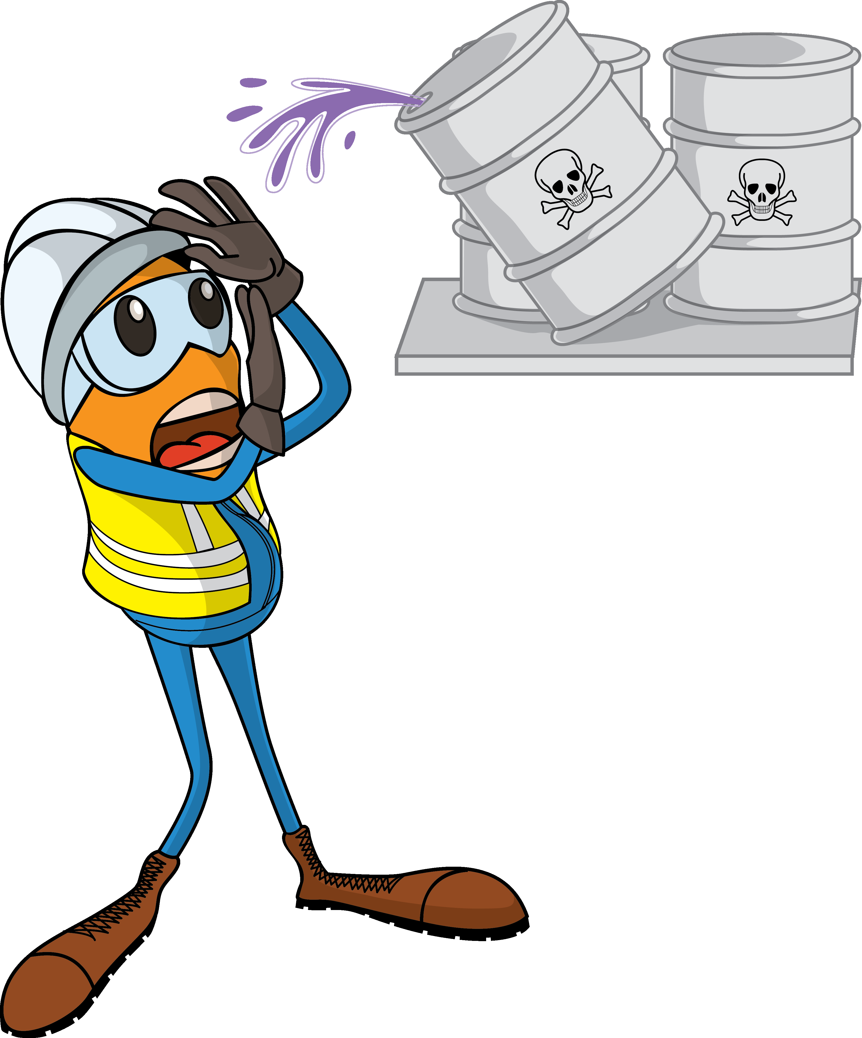
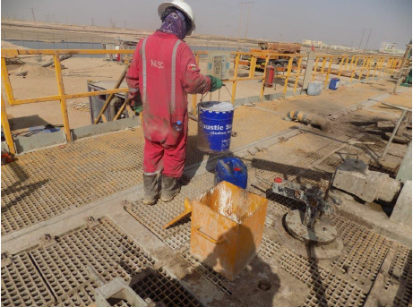
PDO Incident First Alert
Incident Type | LTI#11 | Pattern | Burns
Date / Time | 27.05.2021@09:00hrs | Directorate
Location | Qarn Alam | Dept
Target Audience
Drilling, Operations, Engineering & Construction
What happened
While the Mud Tester was attempting to mix the biocide with pre-existing caustic soda in the tank, the reaction between the two chemicals resulted in splashing the fluid on his face and body causing multiple burn injuries.
Mr. Musleh asks the questions of can it happen to you?
Do you ensure you identify all hazards before starting the task ?
Do you ensure you follow the correct procedure for the task?
Do you ensure you place your body away from the line of fire?
Do you ensure to use the correct PPE for handling chemicals?
Please disseminate this LTI notification to your teams and use it in your tool box talks and HSE meetings and notice boards.
“This document is restricted and it is distributed for information purposes only and it shall not be shared with other than PDO employees and contracts without PDO permission”.

