Slide 1
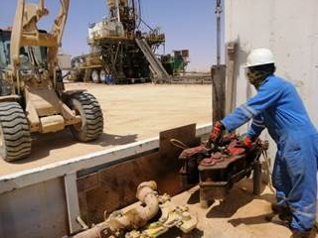
PDO Incident First Alert - PDO
Incident Type | LTI#12 | Pattern | Drops
Date / Time | 29.05.2021@02:00hrs | Directorate
Location | Nimr | Dept
Target Audience
Drilling, Operations, Engineering & Construction
What happened
While the Mechanic was attempting to guide the pipe spinner to its storage position suspended from a forklift boom, the pipe spinner initially rested on the positioning pins and fell down from 20 cm height on his left foot
Mr. Musleh asks the questions of can it happen to you?
Do you ensure you are stood in a safe place away from line of fire?
Do you ensure you identify all hazards before starting the task ?
Do you consider “what could go wrong?”
Do you intervene whenever necessary?
Please disseminate this LTI notification to your teams and use it in your tool box talks and HSE meetings and notice boards.
“This document is restricted and it is distributed for information purposes only and it shall not be shared with other than PDO employees and contracts without PDO permission”.

