Slide 1
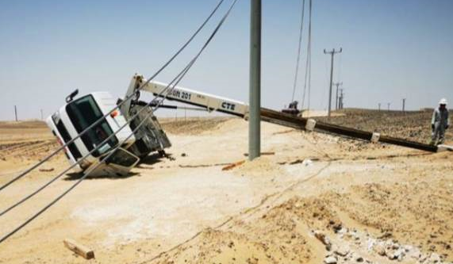
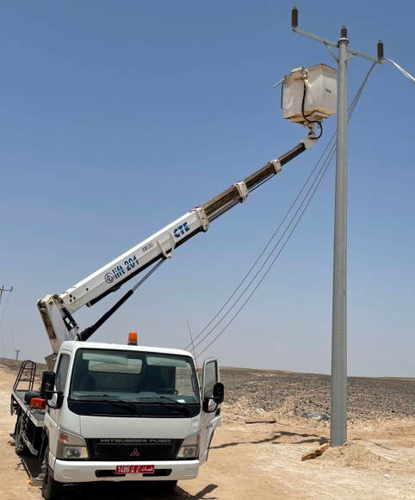
Learning From Incident Awareness Alert
Alert NO | PDO-LFI-LTI#15&16 -202107071120-AW_Final | Pattern | Lifting & Hoisting
Date | 07/07/2021 @ 11:20 | Directorate
Target audience for this alert: Construction, Drilling, Operations ,Engineering, Exploration, Project and Logistic.
Description of the incident:
Two personnel with MEWP (Bucket Truck) were engaged in the conductor activity, while fixing the conductor on the cross arm of the pole, MEWP collapsed and two personnel working inside the bucket got injured due to collapse. Operator got injury to his right arm and the other got back pain.
Why it happened:
Investigation is ongoing
Lessons learned:
Ensure that risk assessment is conducted and discussed prior operation
Ensure following operation manual
Ensure that levelling system is functioning and the machine in leveled position
Ensure that you are working within the safe working load
Ensure that operators is competent for the job.
Ensure that machine has valid inspection certificate
Ensure that maintenance is carried out as per OEM instruction.
Notes:
Target audience for this alert
List the position names or roles that are the target audience for this alert. Wherever possible, the target audience should be limited to those in positions or roles or locations for which the lesson learnt are relevant, or who are required to take action upon receiving this Alert.
Position or role name
Position or role name
Description of the incident:
This should be free text writing and include the relevant facts explaining. what happened to all the relevant parties in a short sharp factual paragraph that describes the incident.
Without mentioning names of contractors or individuals. You should include, what happened, to who (by job title) and what injuries this resulted in. Nothing more
The description should be in sufficient detail to allow a person who does not know anything about the incident to imagine it.
It should only be about what happened and not why it happened.
DO NOT include investigation findings here, simply describe the incident as the investigation has shown it happened.
DO NOT give us a sequence of events here.

