Slide 1
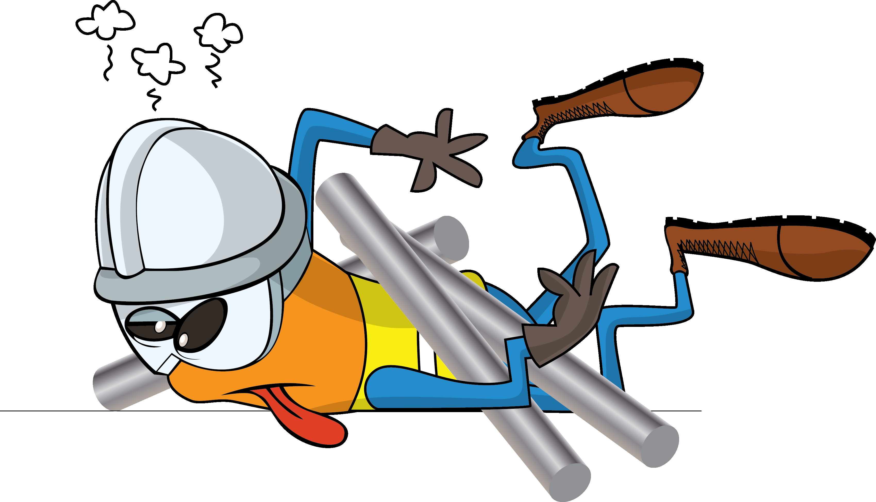
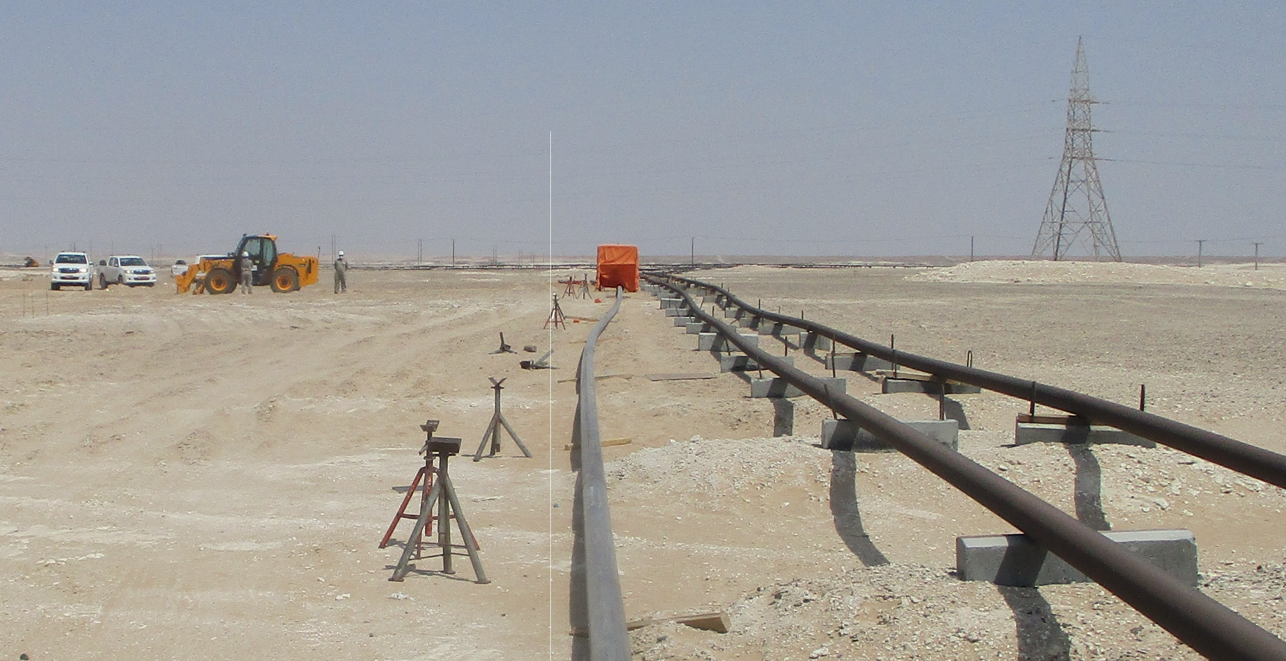
PDO Incident First Alert
Incident Type | LTI#18 | Pattern | Drops
Date / Time | 08.08.2021 @09:09hrs | Directorate
Location | Al Huwaisa, Yibal | Dept
Target Audience
Drilling, Operations, Engineering & Construction
What happened
While a mechanical crew was placing a pipe on wooden skids, the pipe became imbalanced and fell on the Fitter who was performing buffing activity inside a welding booth causing fracture to his left side pelvis.
Mr. Musleh asks the questions of can it happen to you?
Do you ensure you identify all hazards before starting a task?
Do you consider “what could go wrong?”
Do you follow the procedure correctly?
Do you ensure you stand in a safe zone?
Please disseminate this LTI notification to your teams and use it in your tool box talks and HSE meetings and notice boards.

