Slide 1
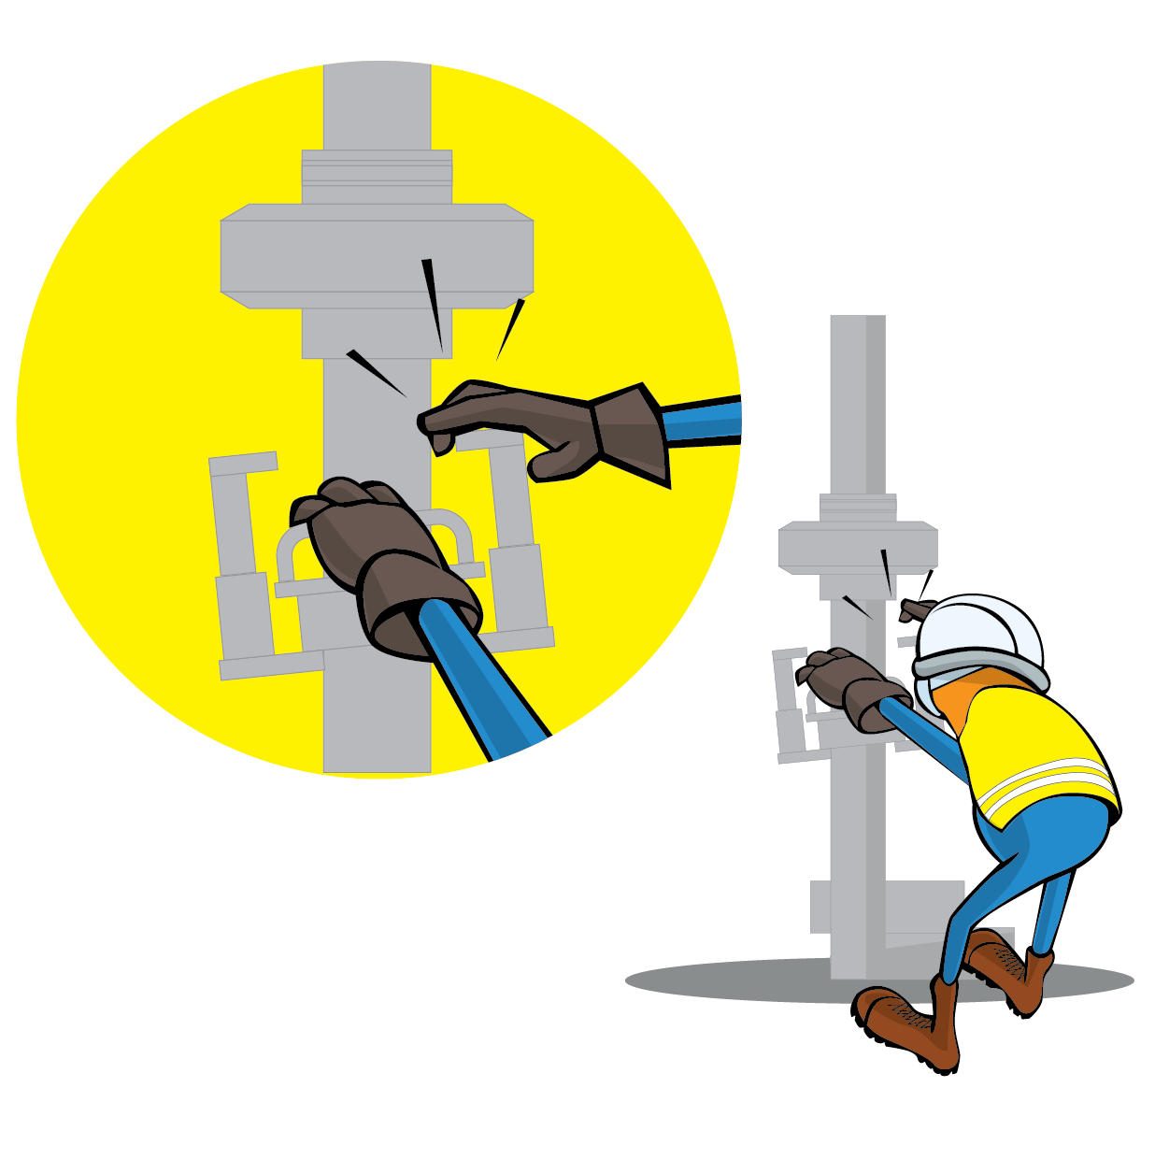
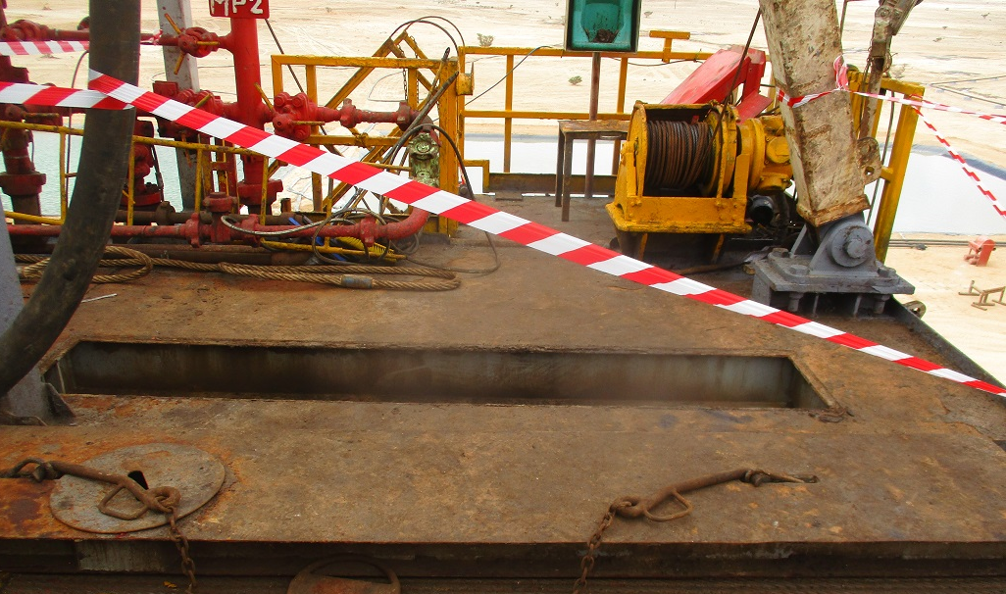
PDO Incident First Alert
Incident Type | LTI#19 | Pattern | Fall from Height
Date / Time | 20.08.2021@05:30hrs | Directorate
Location | Rig-32, Nimr | Dept
Target Audience
Drilling, Operations, Engineering & Construction
What happened
While the Floorman was assisting in removing a plate from the Rig floor in preparation for lowering the mast, he fell from the rig floor (8.3m) through the opening and rested on substructure area causing fracture to his hip.
Mr. Musleh asks the questions of can it happen to you?
Do you ensure you identify all hazards before starting a task?
Do you ensure you are in a safe position while performing a task?
Do you consider the risk of fall from height?
Please disseminate this LTI notification to your teams and use it in your tool box talks and HSE meetings and notice boards.

