Slide 1
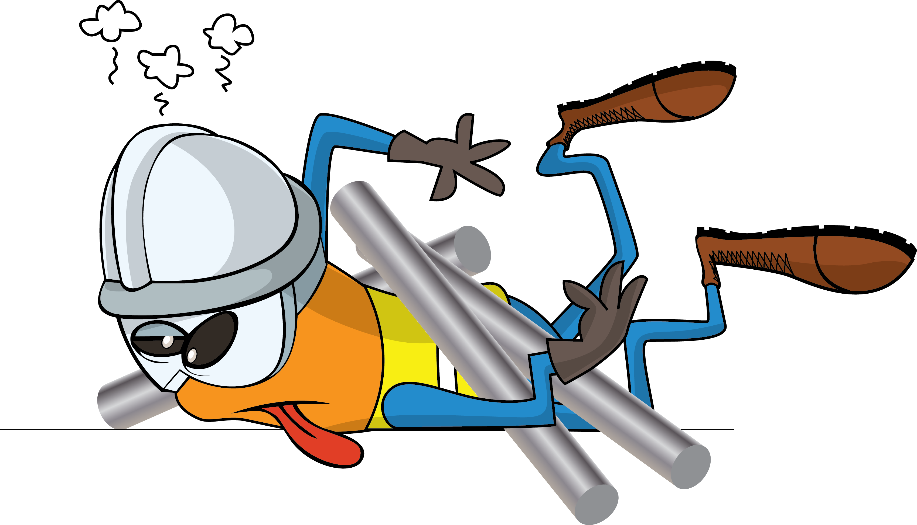
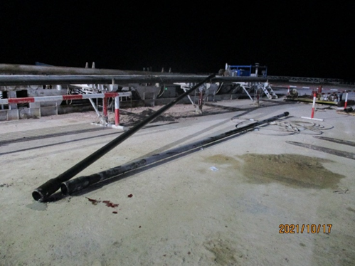
PDO Incident First Alert
Incident Type | LTI#23 | Pattern | Drops
Date / Time | 16.10.2021@23:51hrs | Directorate
Location | Lekhwair | Dept
Target Audience
Drilling, Operations, Engineering & Construction
What happened
While the Night Tool Pusher was attempting to stop the forklift from removing the unstable drill pipes on the catwalk, one drill pipe rolled across another dill pipe hitting his left leg causing fracture.
Mr. Musleh asks the questions of can it happen to you?
Do you ensure you are stood in a safe place away from line of fire?
Do you ensure you identify all hazards before starting the task ?
Do you consider “what could go wrong?”
Do you intervene whenever necessary?
Do you ensure no go zone barrier in place and adequately controlled?
Please disseminate this LTI notification to your teams and use it in your tool box talks and HSE meetings and notice boards.
“This document is restricted and it is distributed for information purposes only and it shall not be shared with other than PDO employees and contracts without PDO permission”.

